Slide 1
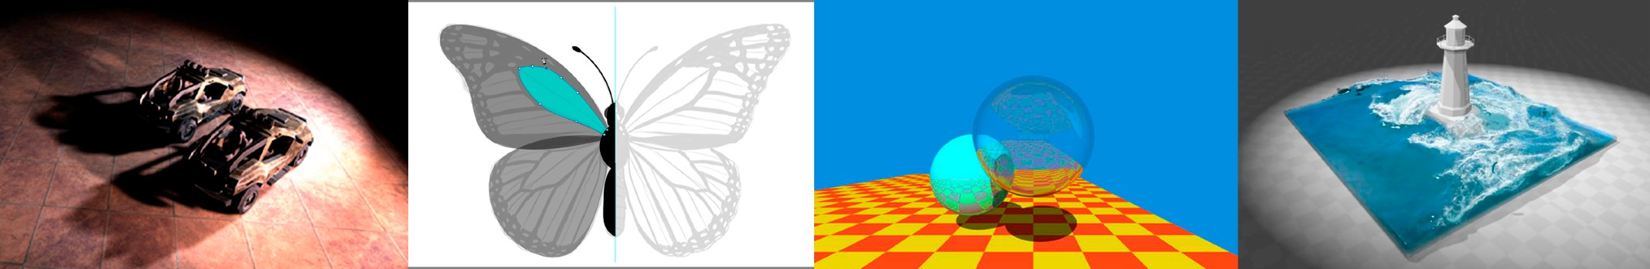
Introduction to Computer Graphics
Transformation & Basic Rasterization
http://www.cs.ucsb.edu/~lingqi/teaching/games101.html

Slide 2
Graphics Pipeline
3
Application
1
4
Input: vertices in 3D space
2
Vertex Processing
Vertex Stream
Vertices positioned in screen space
Triangle Processing
Triangle Stream
Triangles positioned in screen space
Rasterization
Fragment Stream
Fragments (one per covered sample)
Fragment Processing
Shaded Fragments
Shaded fragments
Framebuffer Operations
Display
Output: image (pixels)

Slide 3
A Swift and Brutal Introduction to Linear Algebra!
(in fact it’s relatively easy…)

Slide 4
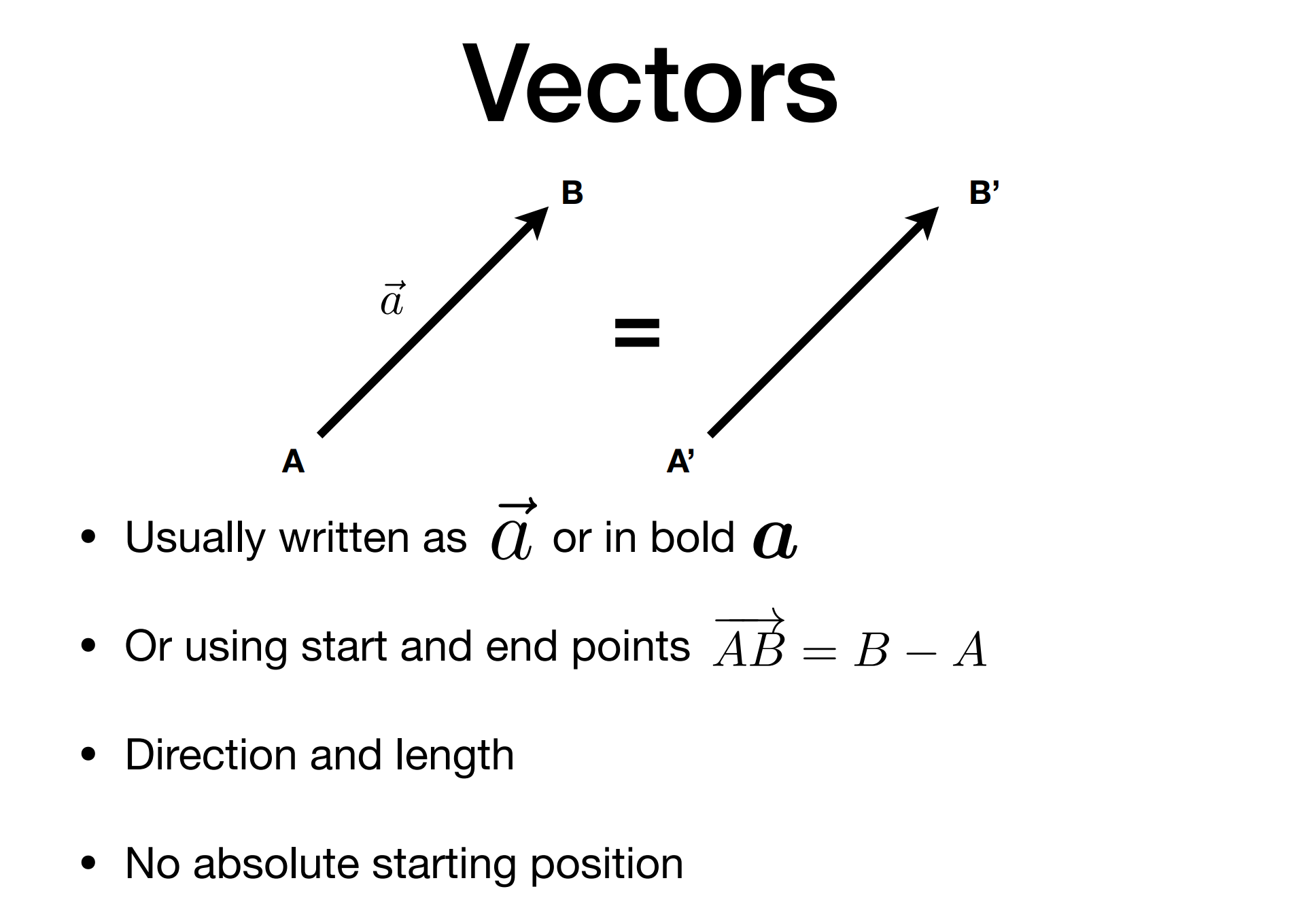
Vectors
B
B’
=
A A’
Usually written as ~a or in bold
Or using start and end points —A—→B = B
Direction and length
No absolute starting position
A

Slide 5
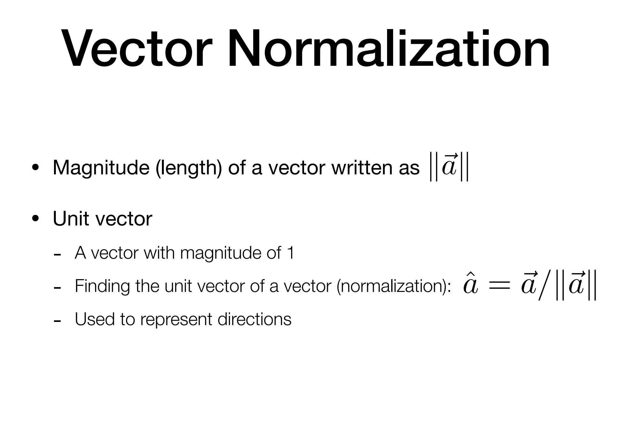

Vector Normalization
Magnitude (length) of a vector written as ~a
Unit vector
-
-
-
A vector with magnitude of 1
Finding the unit vector of a vector (normalization): aˆ = ~a/ ~a
Used to represent directions

Slide 6
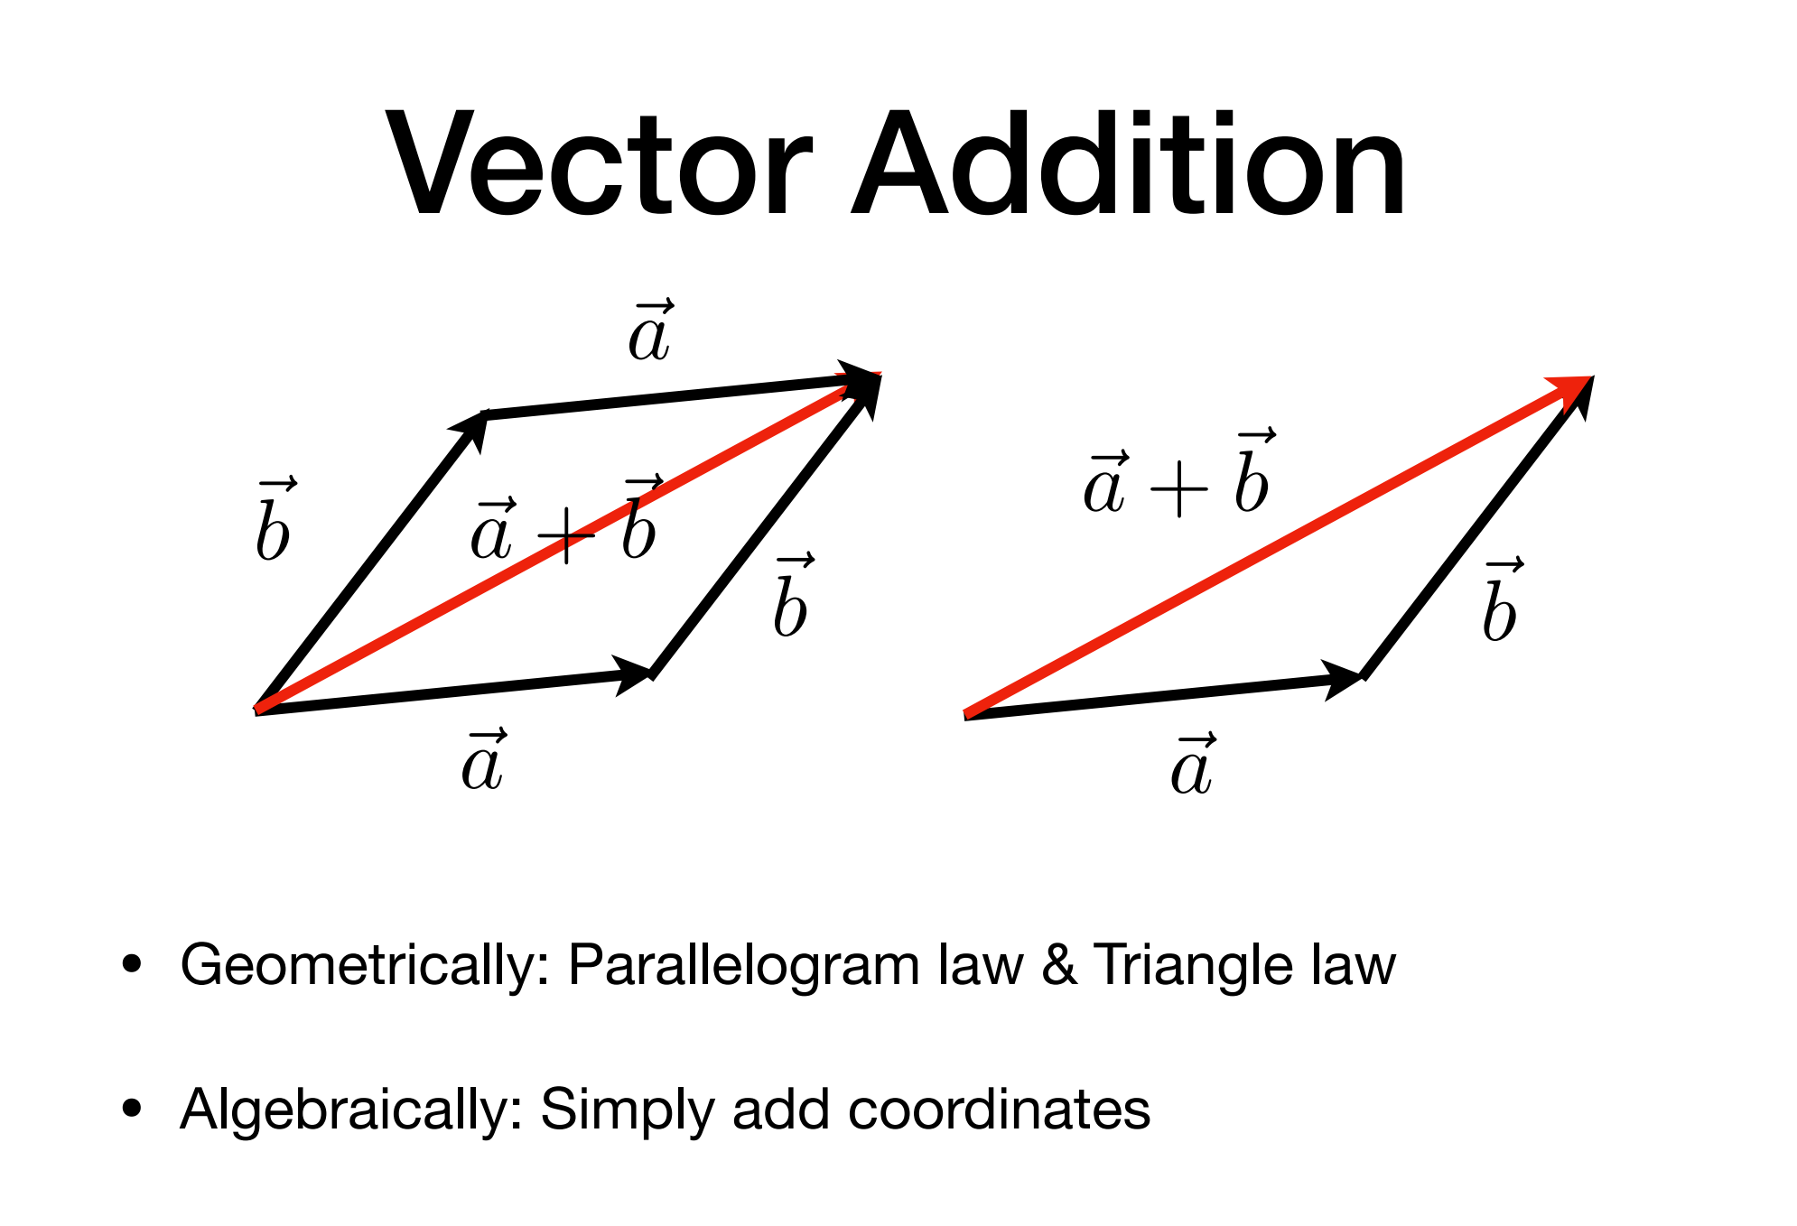
Vector Addition
~a
~_{b}
~a + ~b
~a + ~b
~
~_{b}
b
~a
~a
Geometrically: Parallelogram law & Triangle law
Algebraically: Simply add coordinates

Slide 7
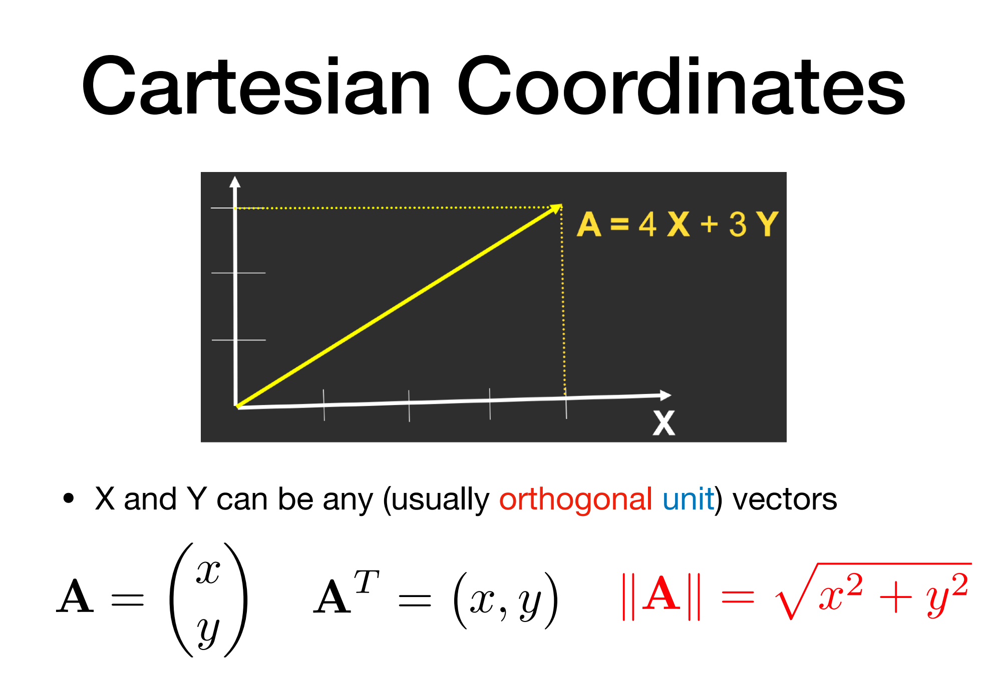
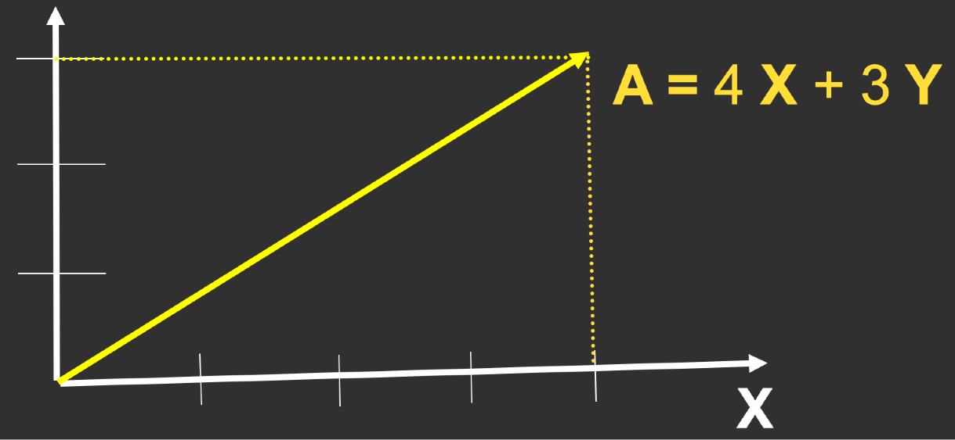

Cartesian Coordinates
X and Y can be any (usually orthogonal unit) vectors
✓
x y
_{A}T
A =
= x, y
A = x² + y²

Slide 8
Vector Multiplication
Dot product
Cross product
Orthonormal bases and coordinate frames

Slide 9
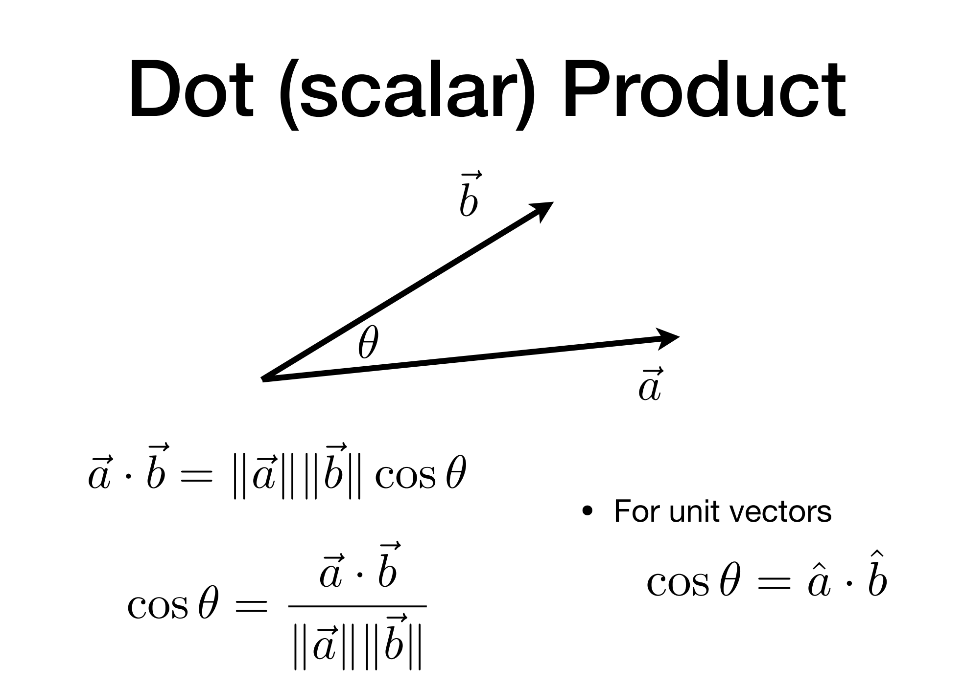

Dot (scalar) Product
~_{b}
✓
~a
~a · ~b = ~a
cos ✓ =
~_{b}
cos ✓
For unit vectors
cos ✓ = aˆ
~a · ~b
ˆ_{b}
~a
~_{b}

Slide 10
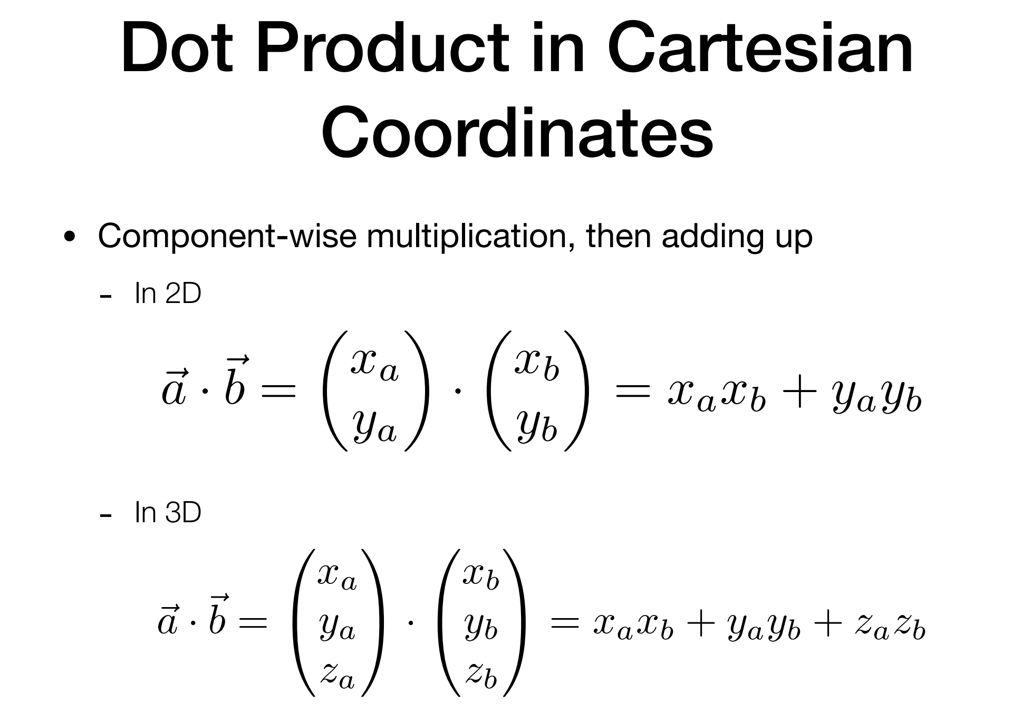
Dot Product in Cartesian Coordinates
Component-wise multiplication, then adding up
- In 2D
✓ ◆ ✓ ◆
x x
~
a b
~a · b =
In 3D
· = x
x + y y
y_{a} y_{b}
a b
a b
-
0_{xa}1 0_{xb}1
~
@ A
@ A
~a · b = y ·
y
= x x + y y + z z
a
b
a b
a b
a b
z_{a}
z_{b}

Slide 11
Vector Multiplication
Dot product
Cross product
Orthonormal bases and coordinate frames

Slide 12
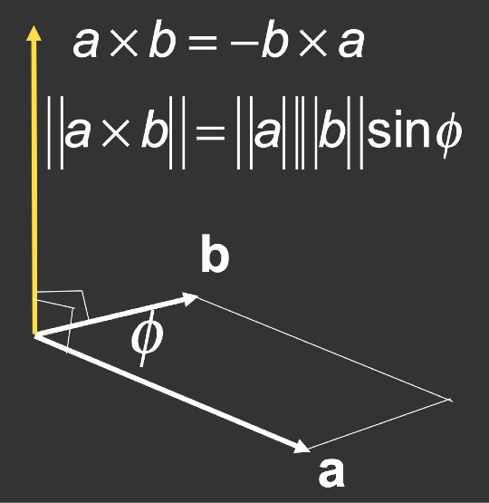
Cross (vector) Product
Cross product is orthogonal to two initial vectors
Direction determined by right-hand rule
Useful in constructing coordinate systems (later)

Slide 13
Vector Multiplication
Dot product
Cross product
Orthonormal bases and coordinate frames

Slide 14
Orthonormal Bases / Coordinate Frames
Important for representing points, positions, locations
Often, many sets of coordinate systems
Global, local, world, model, parts of model (head,
hands, …)
Critical issue is transforming between these systems/ bases
A topic for next week

Slide 15
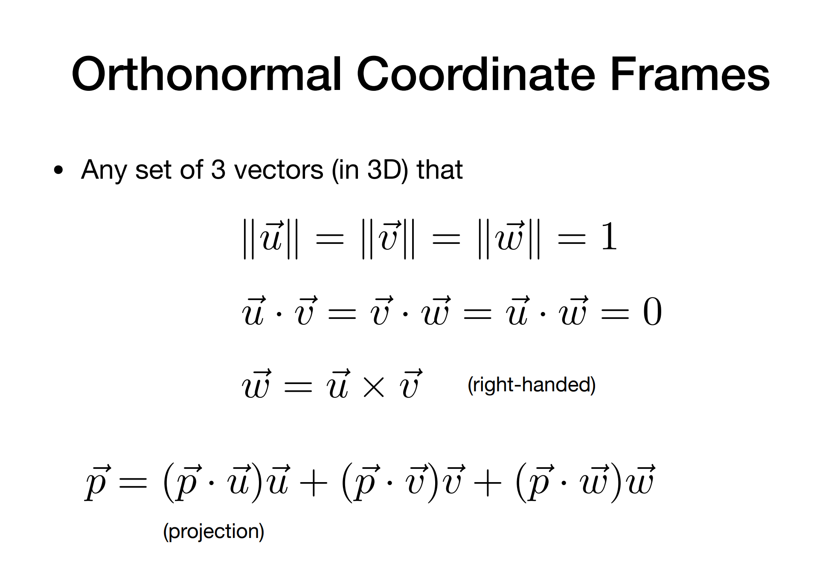
Orthonormal Coordinate Frames
Any set of 3 vectors (in 3D) that
~u = ~v = w~ = 1
~u ~v = ~v w~ = ~u w~ = 0
w~ = ~u ~v
(right-handed)
p~ = (p~ · ~u)~u + (p~ · ~v)~v + (p~ · w~ )w~
(projection)

Slide 16
Matrices
Magical 2D arrays that haunt in every CS course
In Graphics, pervasively used to represent transformations
- Translation, rotation, shear, scale (more details in the next lecture)

Slide 17
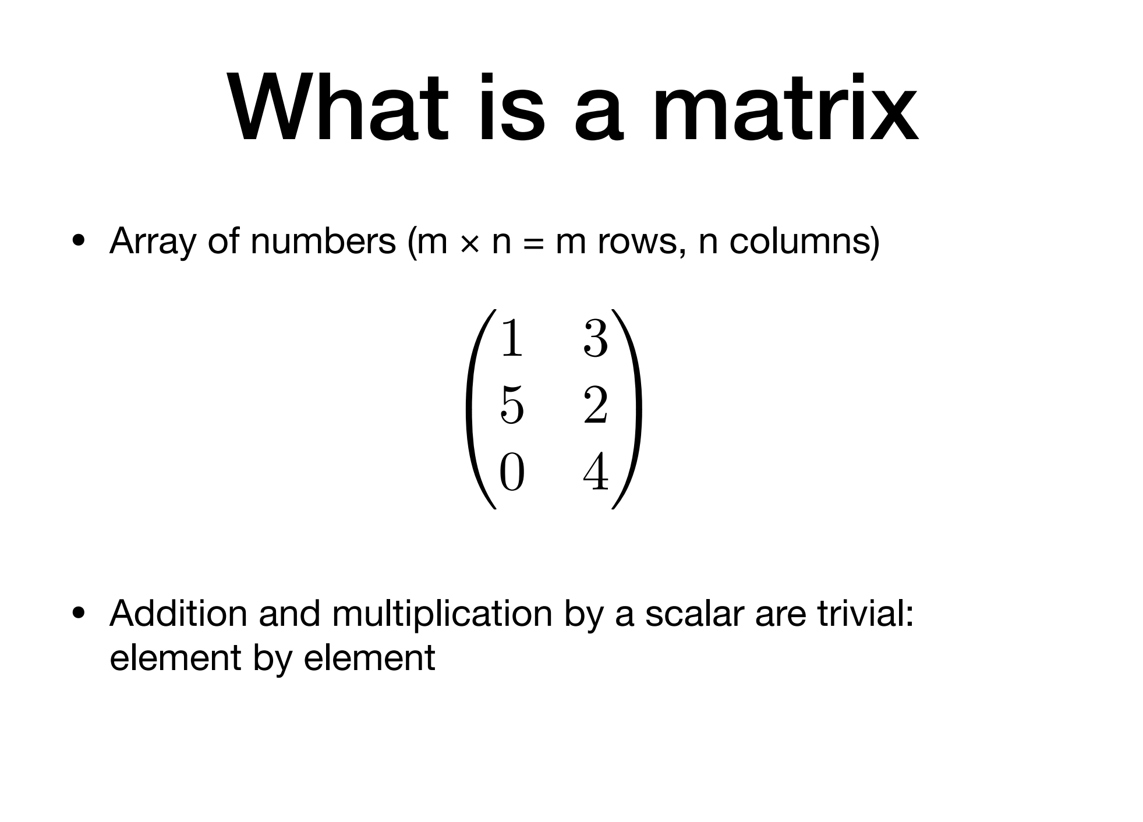
What is a matrix
Array of numbers (m × n = m rows, n columns)
0 1
1 3
5 2
0 4
Addition and multiplication by a scalar are trivial: element by element

Slide 18
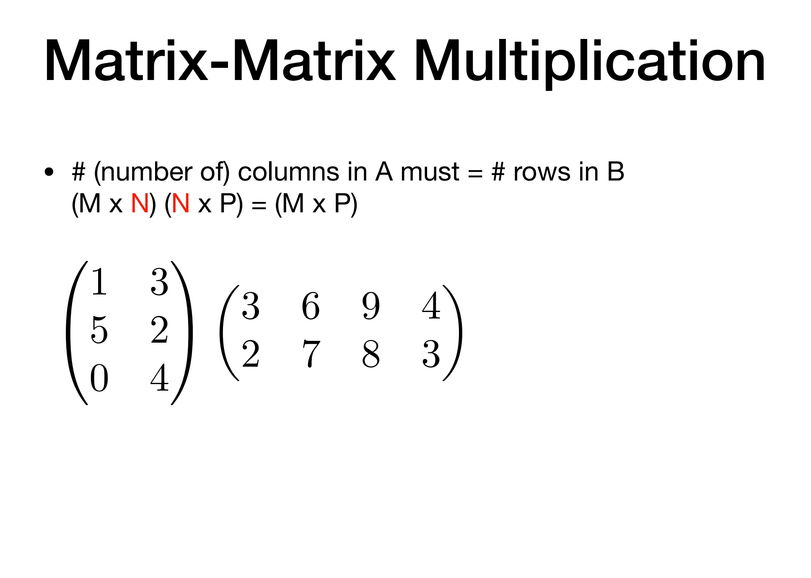
Matrix-Matrix Multiplication
# (number of) columns in A must = # rows in B (M x N) (N x P) = (M x P)
0 1
1 3
◆
3 6 9 4
2 7 8 3
5 2
A
0 4

Slide 19
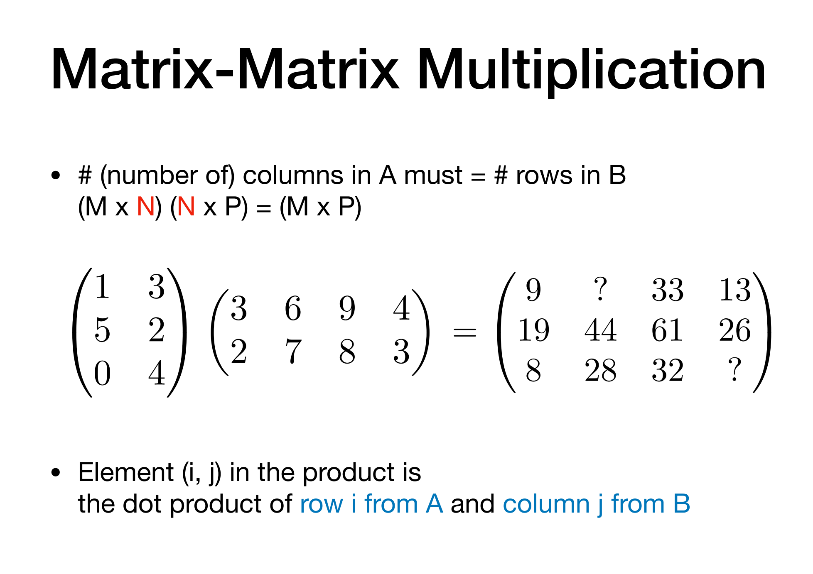
Matrix-Matrix Multiplication
# (number of) columns in A must = # rows in B (M x N) (N x P) = (M x P)
0 1
0 1
1 3
5 2
0 4
◆
9 ? 33 13
19 44 61 26
8 28 32 ?
3 6 9 4
2 7 8 3
A
=
@
Element (i, j) in the product is
the dot product of row i from A and column j from B

Slide 20
Matrix-Matrix Multiplication
Properties
Non-commutative
(AB and BA are different in general)
Associative and distributive
-
-
-
(AB)C=A(BC) A(B+C) = AB + AC (A+B)C = AC + BC

Slide 21
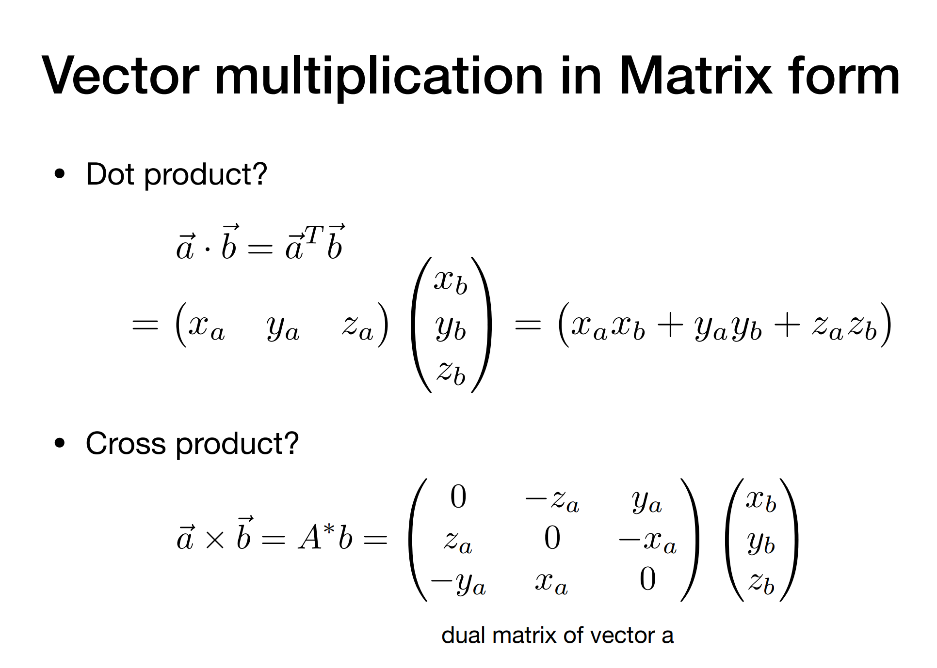
Vector multiplication in Matrix form
Dot product?
0 1
~a ~b = ~a^{T~}b
x
b
@ A
= x_{a} y_{a} z_{a} y
= x_{a}x_{b} + y_{a}y_{b} + z_{a}z_{b}
b
z_{b}
Cross product?
0@
1 0_{xb}1
0 —z_{a} y_{a}
z_{a} 0 —x
—y_{a} x_{a} 0
~
⇤
A @
y
~a × b = A b =
a
b
z_{b}
dual matrix of vector a

Slide 22
Transformation
Model transformation (placing objects)
View transformation (placing camera)
Projection transformation
-
-
Orthographic projection (cuboid to “canonical” cube [-1, 1]³) Perspective projection (frustum to “canonical” cube)

Slide 23
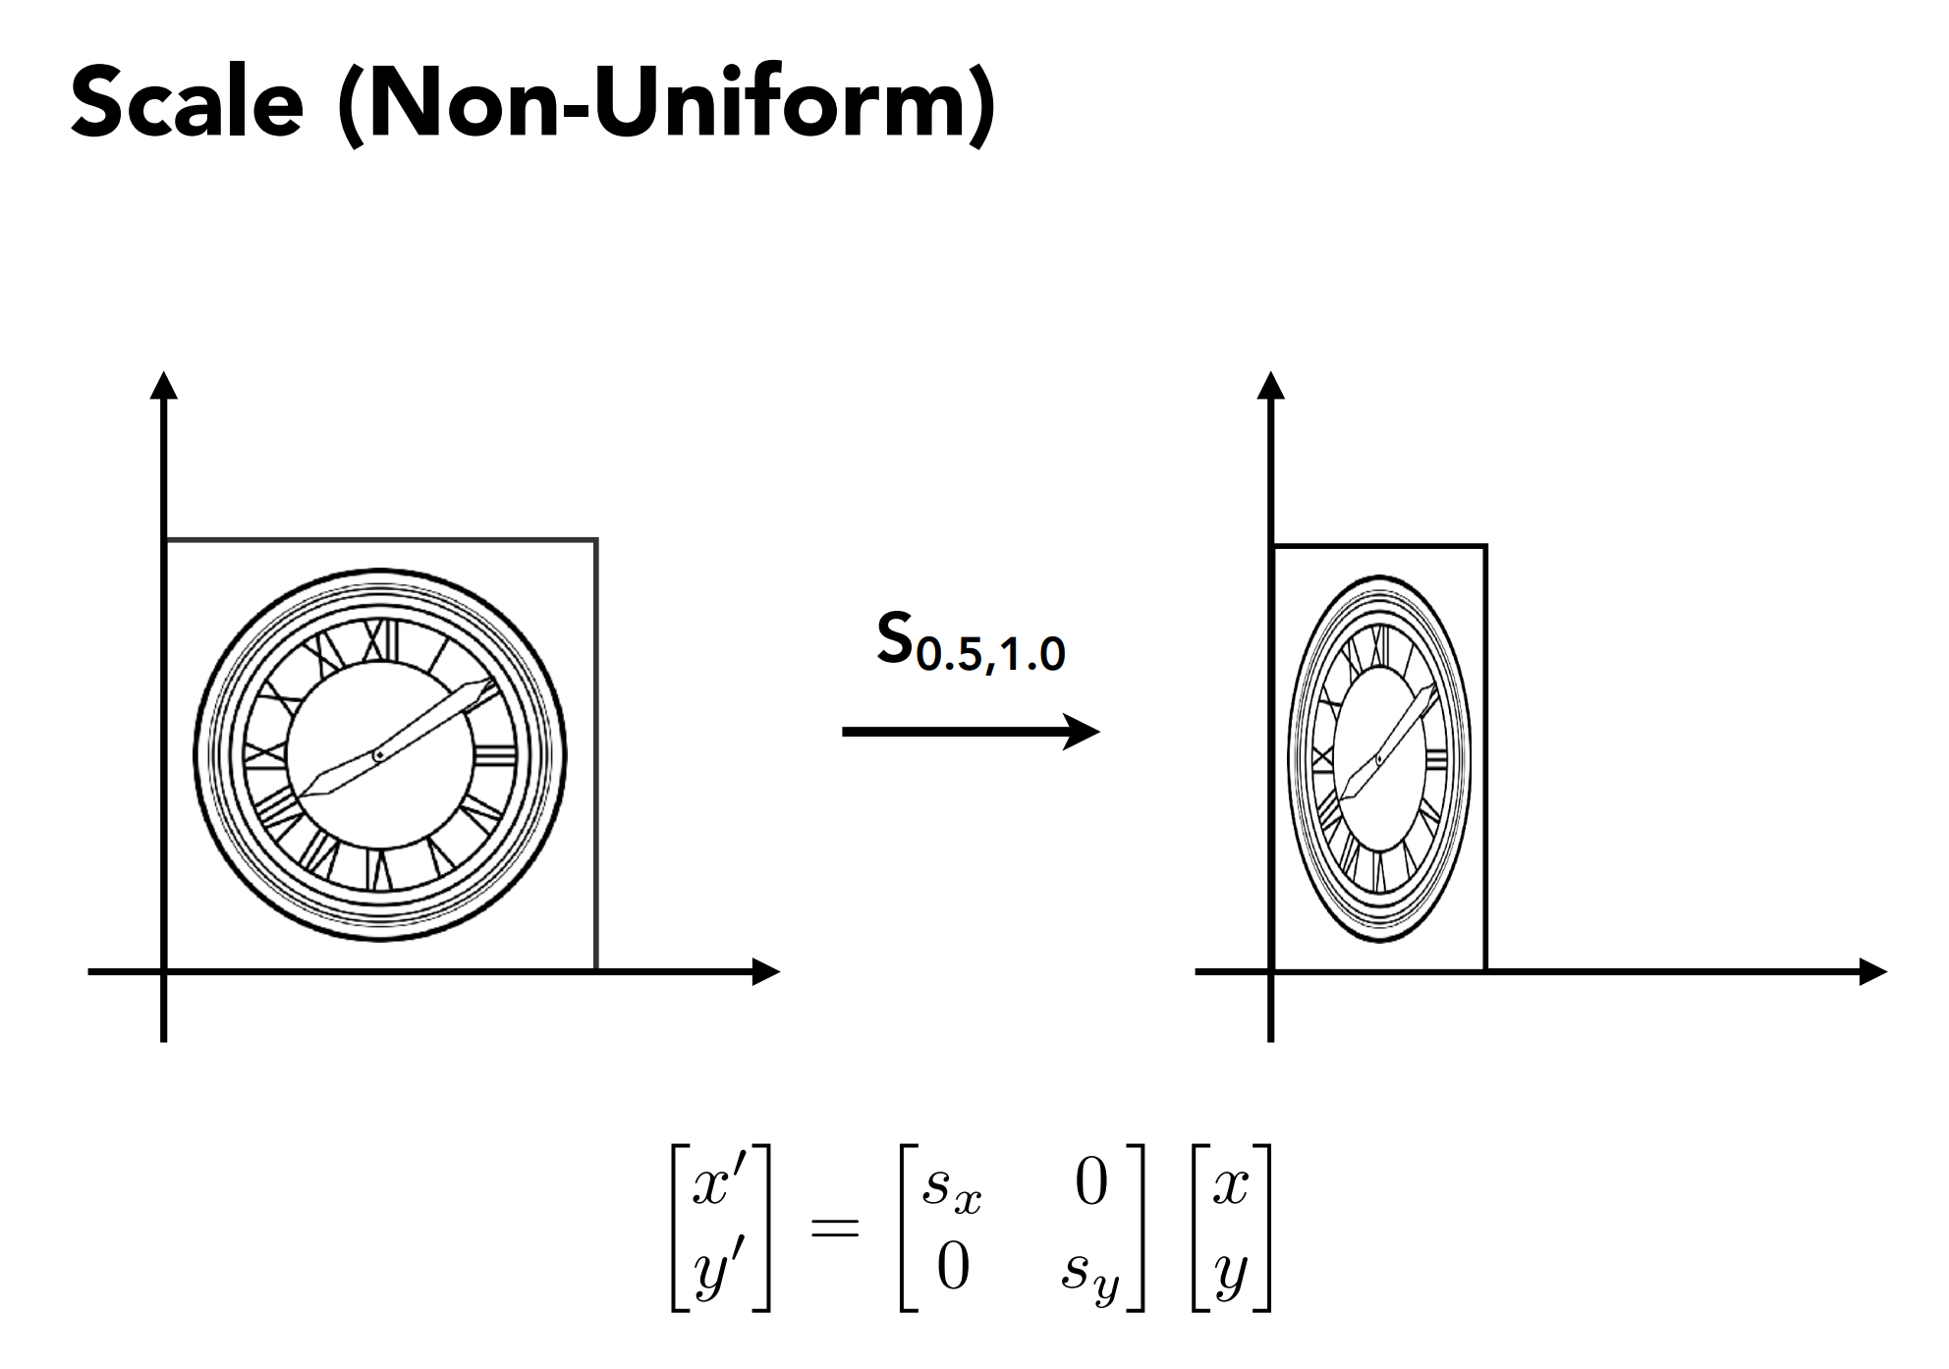

Slide 24
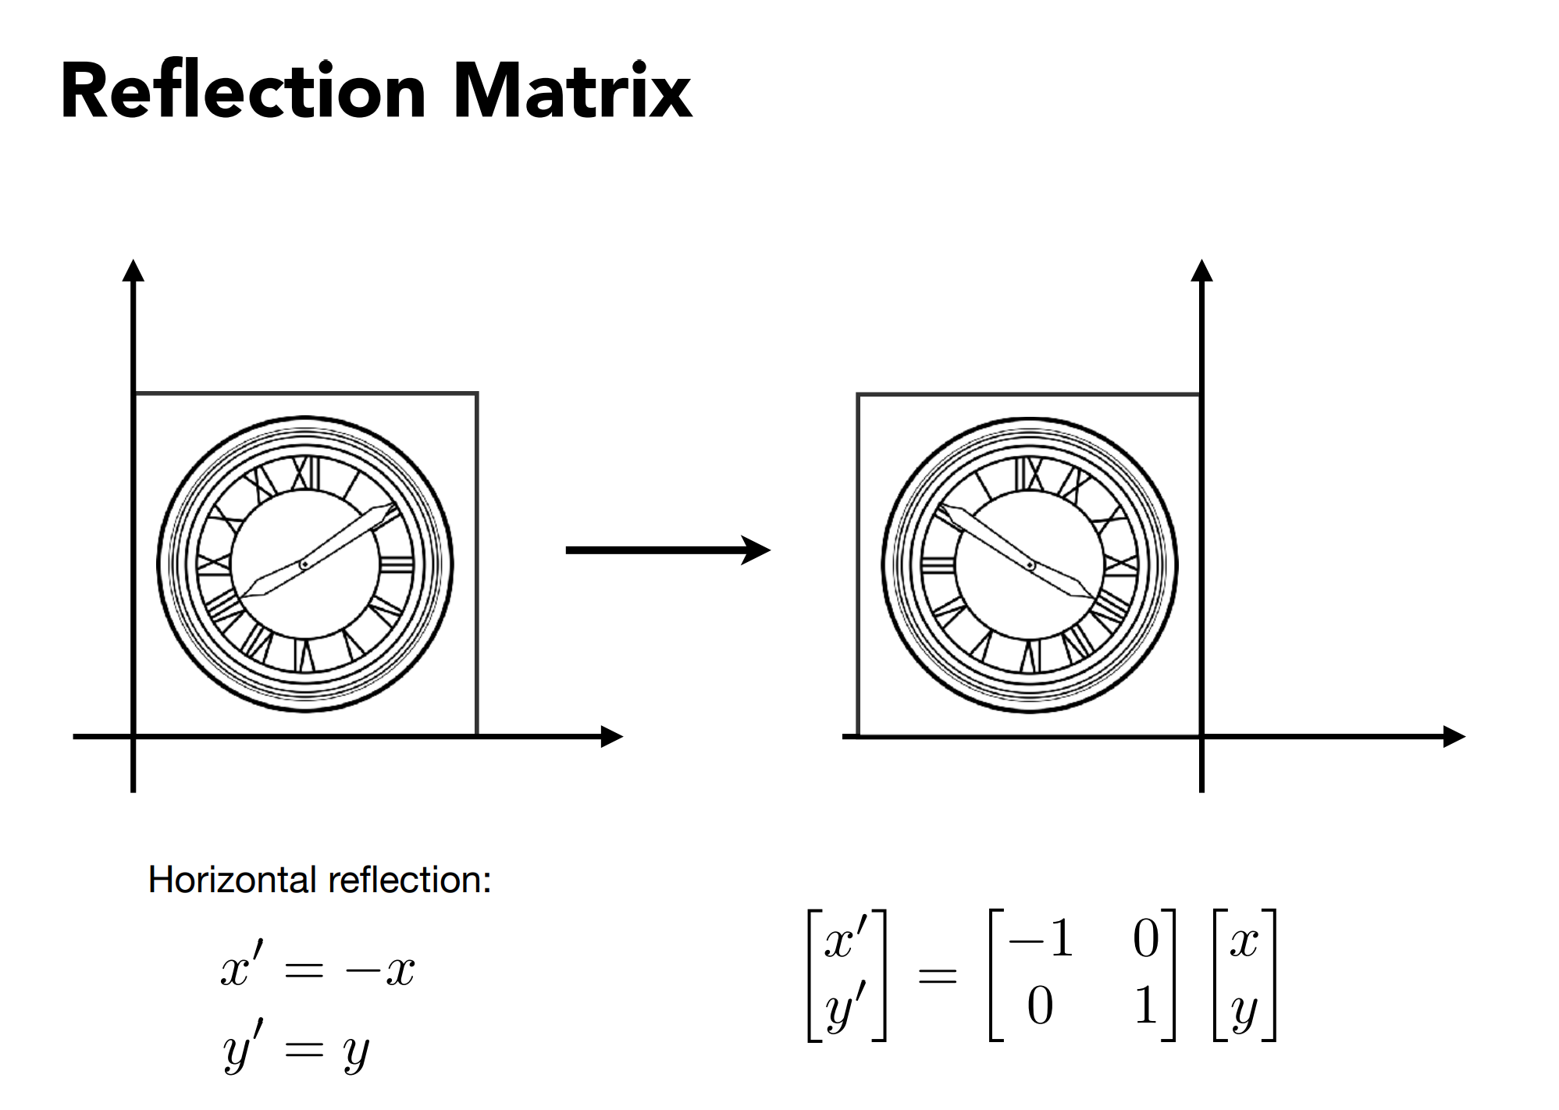

Slide 25
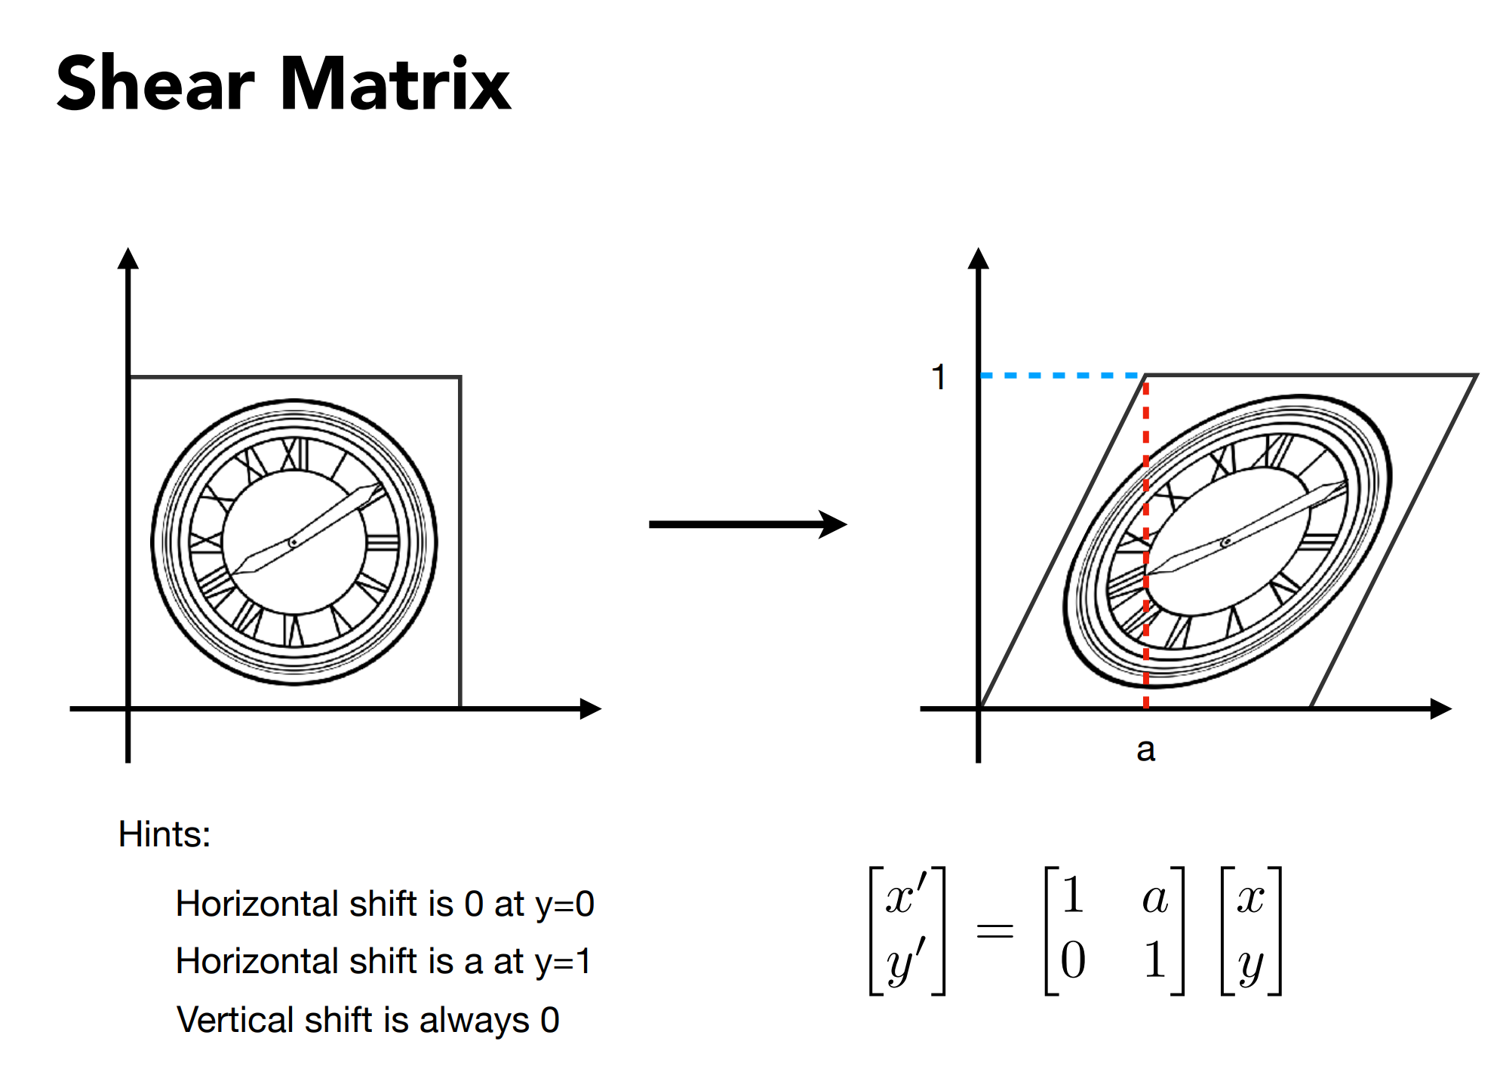

Slide 26
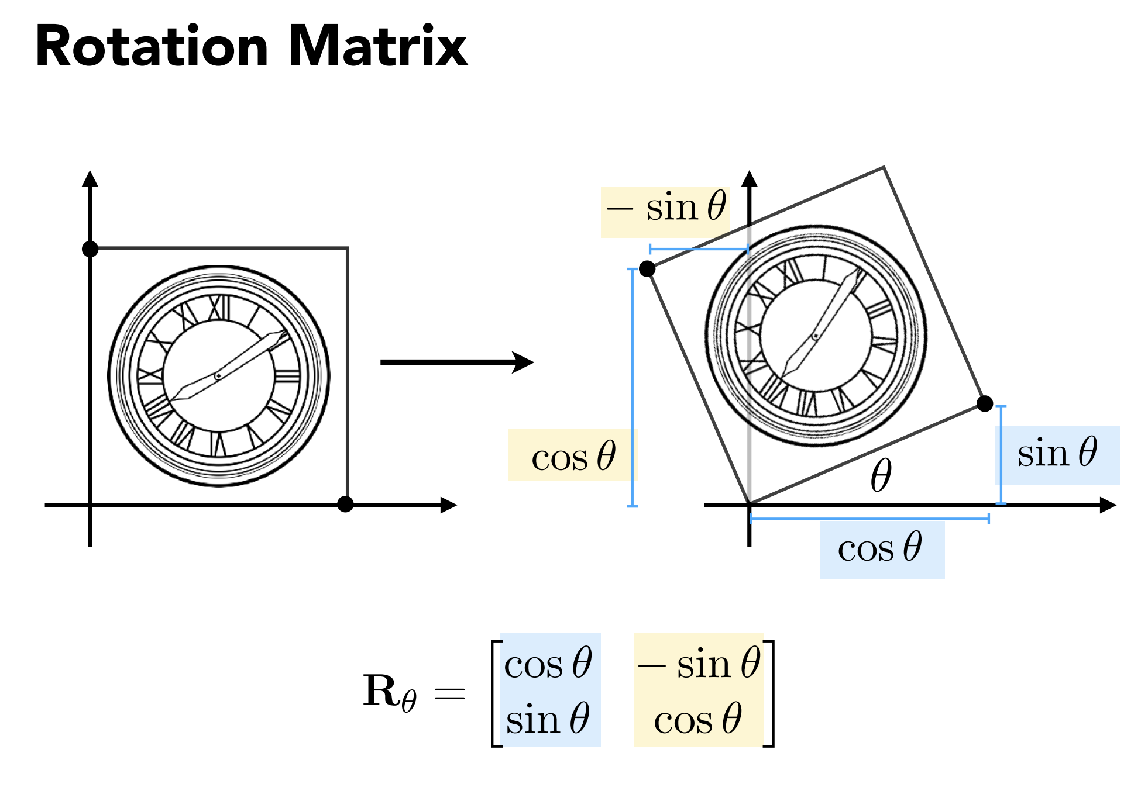

Slide 27
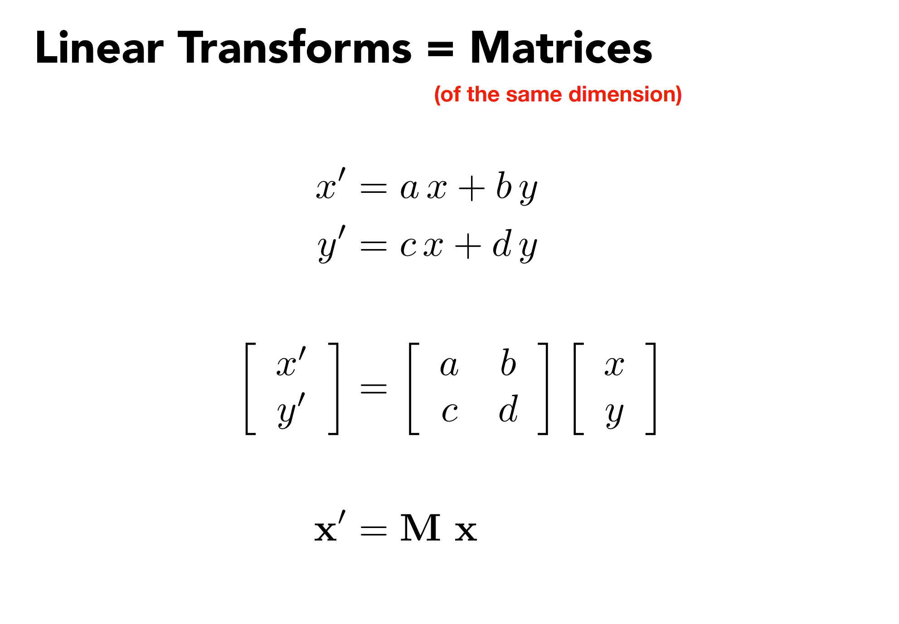

Slide 28
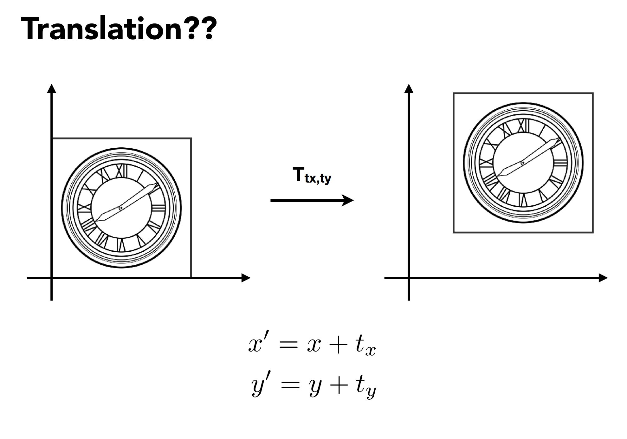

Slide 29
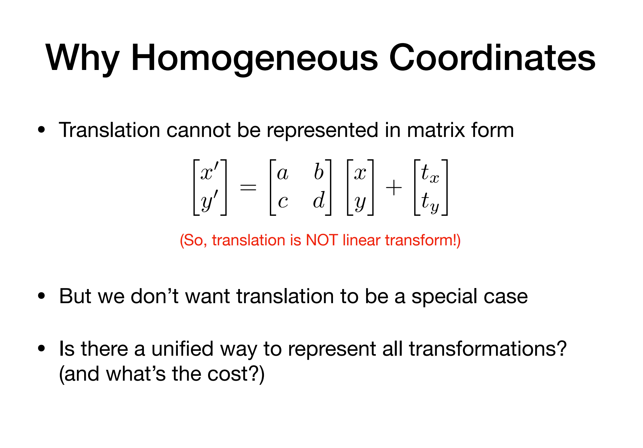

Slide 30
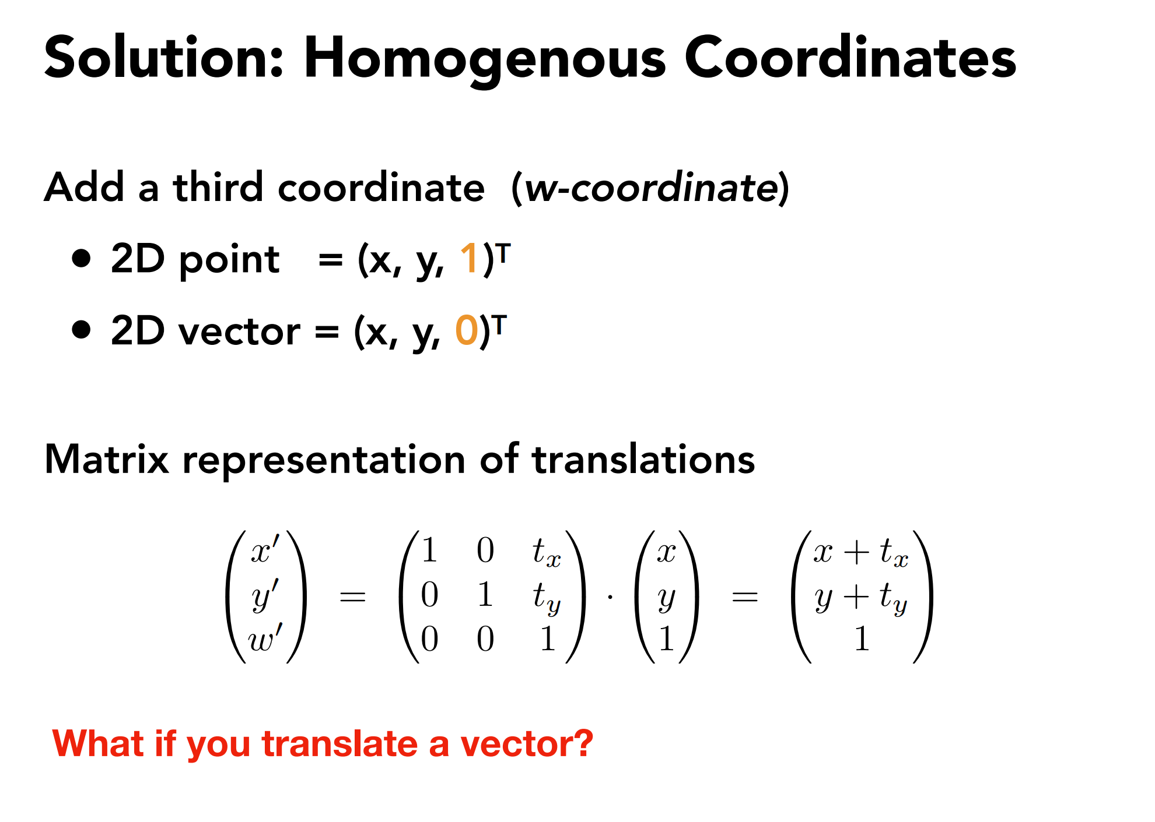

Slide 31
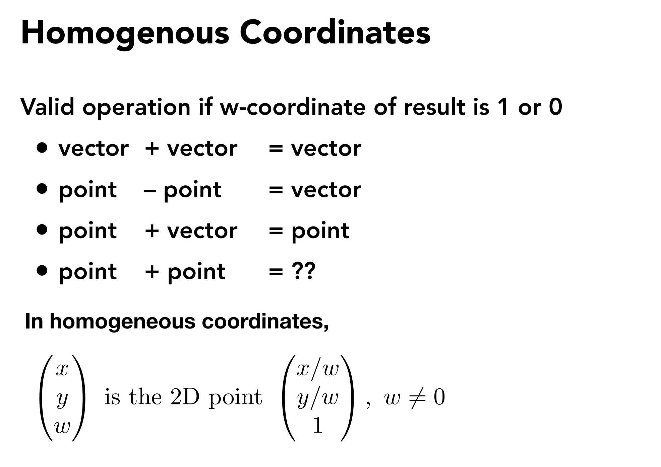

Slide 32
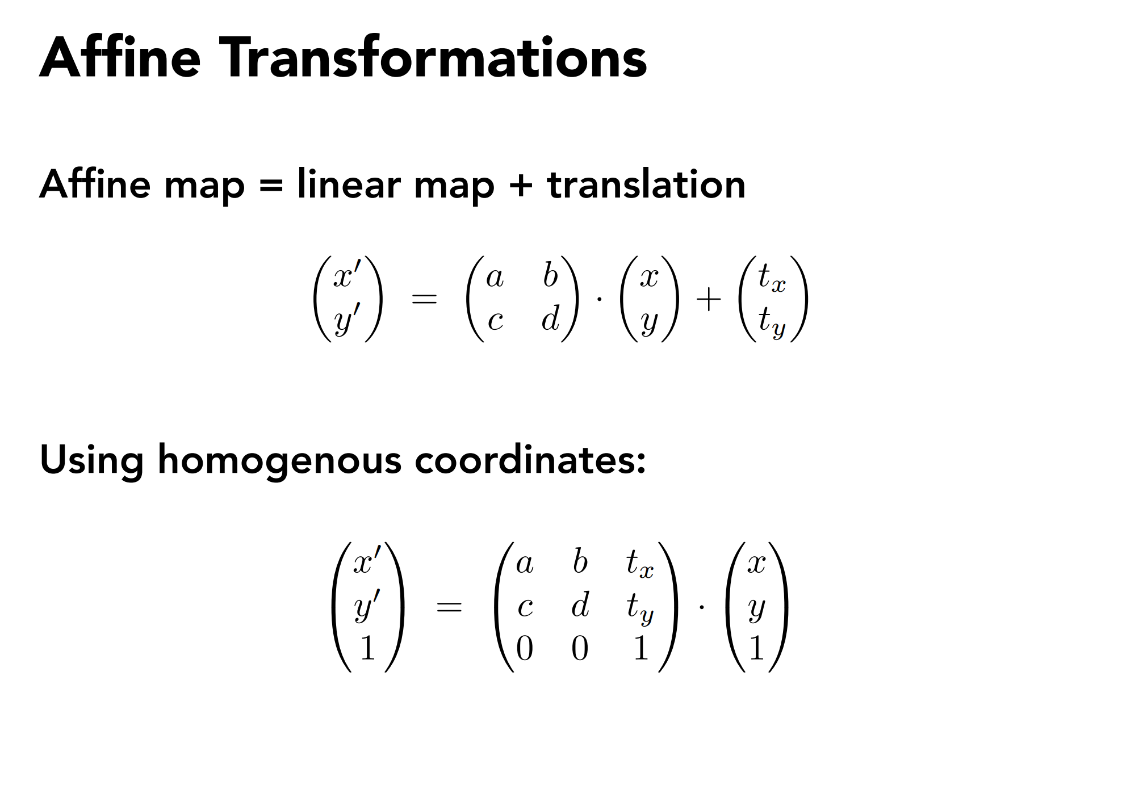

Slide 33
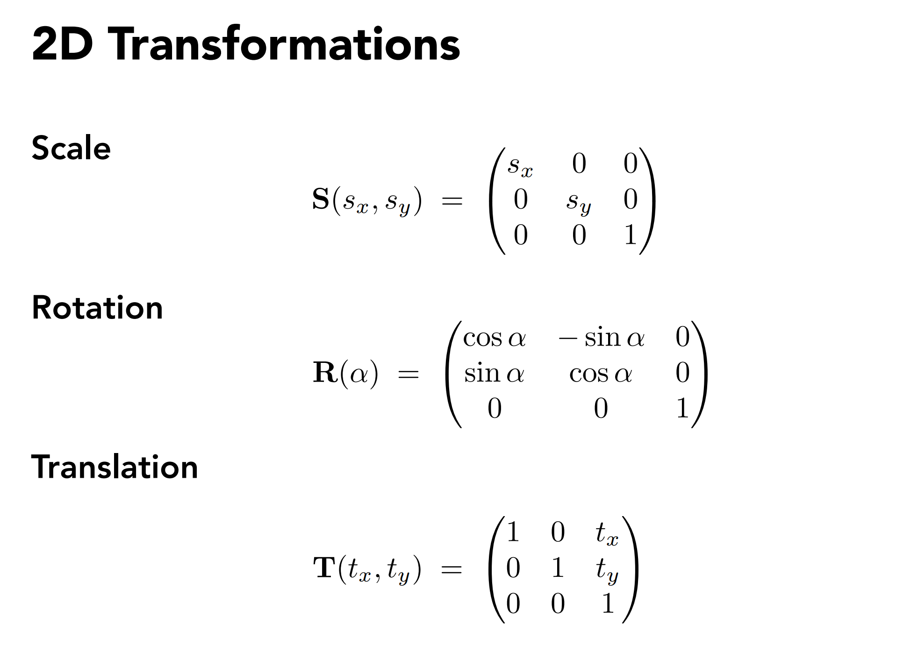

Slide 34
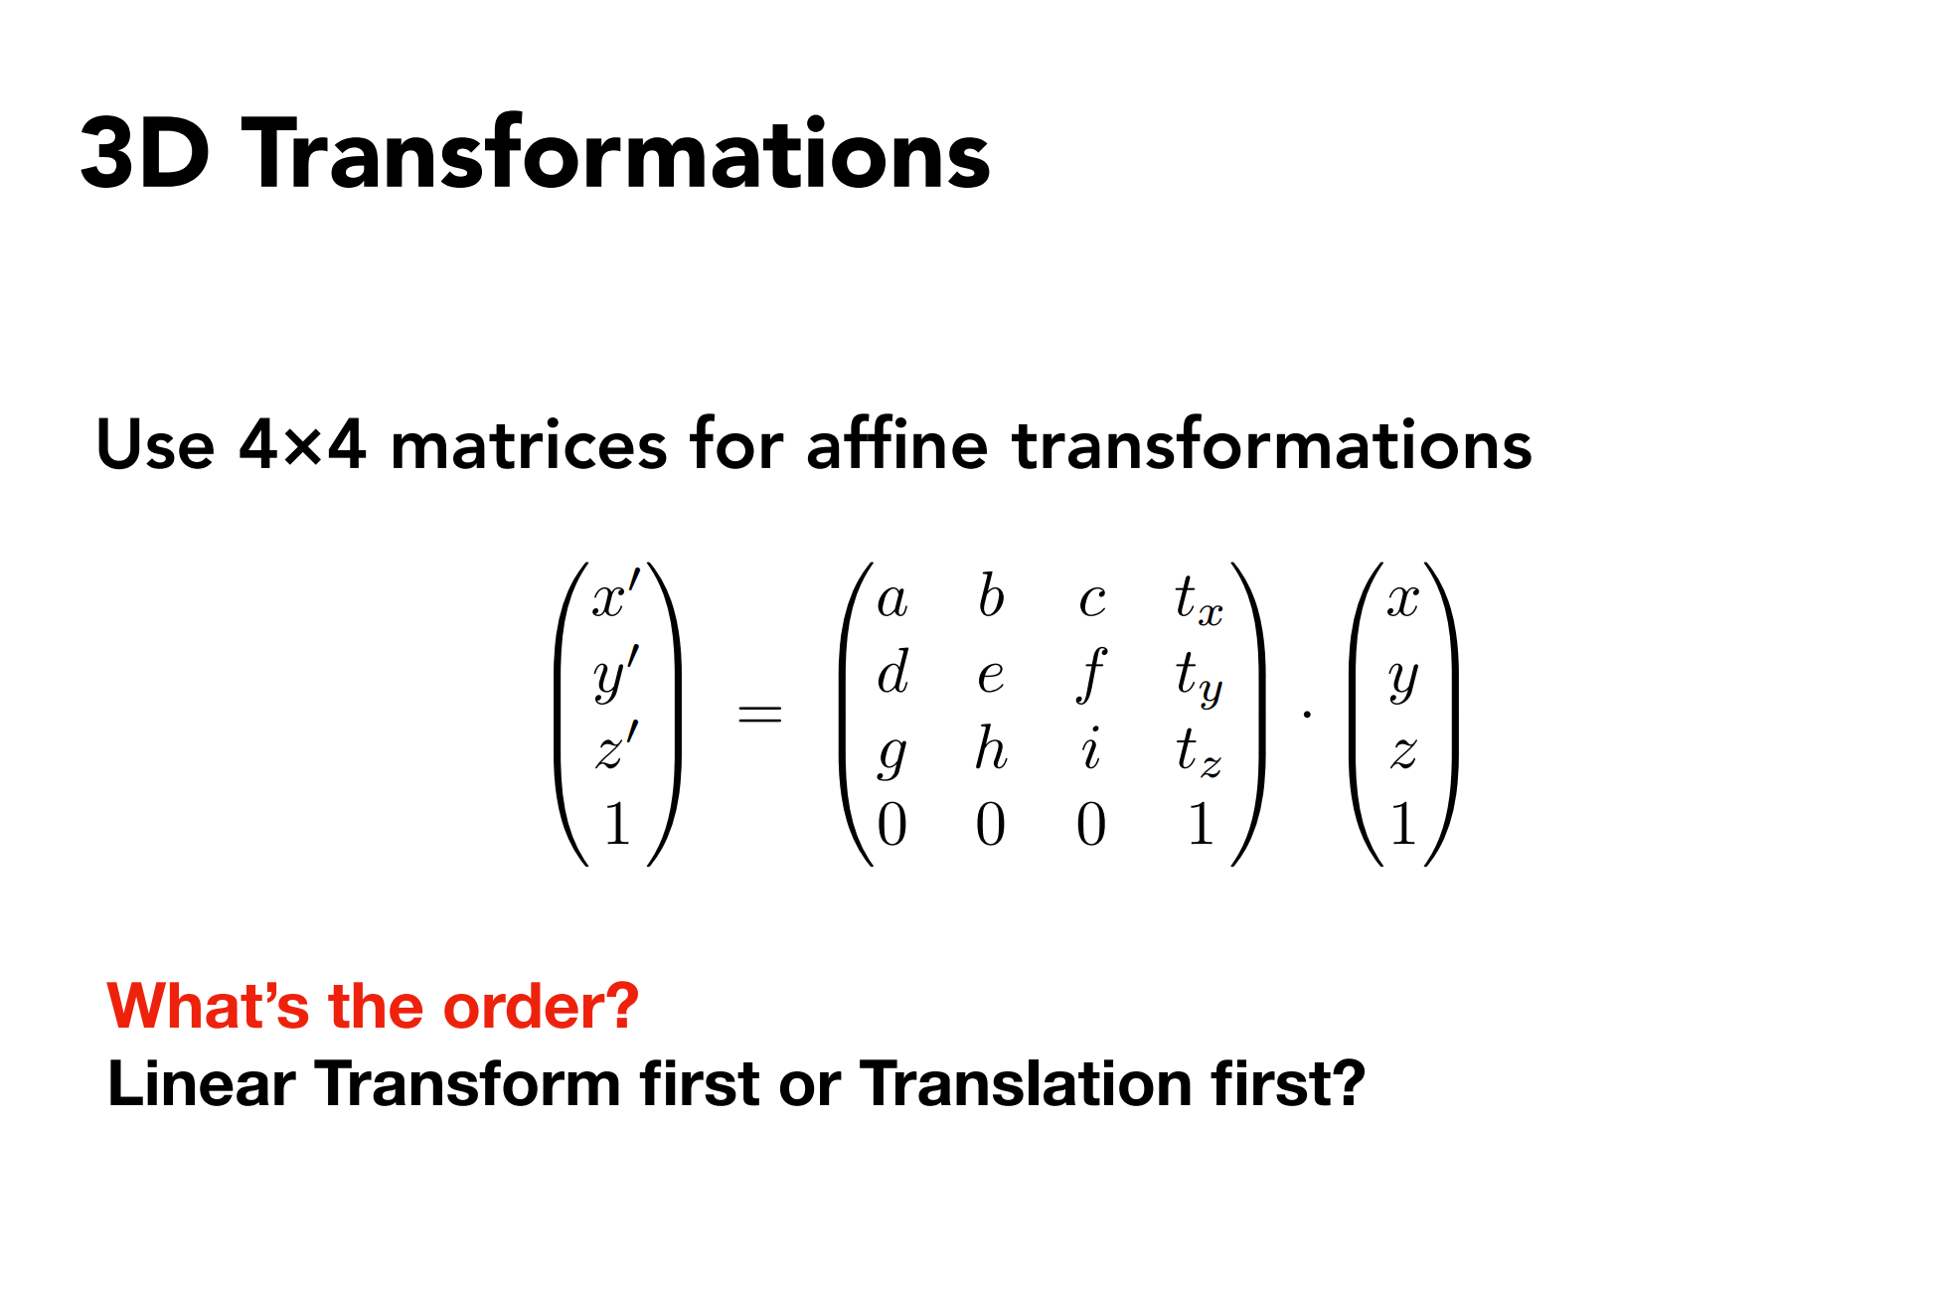

Slide 35
3D transformations
Viewing (观测) transformation
-
-
View (视图) / Camera transformation
Projection (投影) transformation
-
-
Orthographic (正交) projection
Perspective (透视) projection

Slide 36
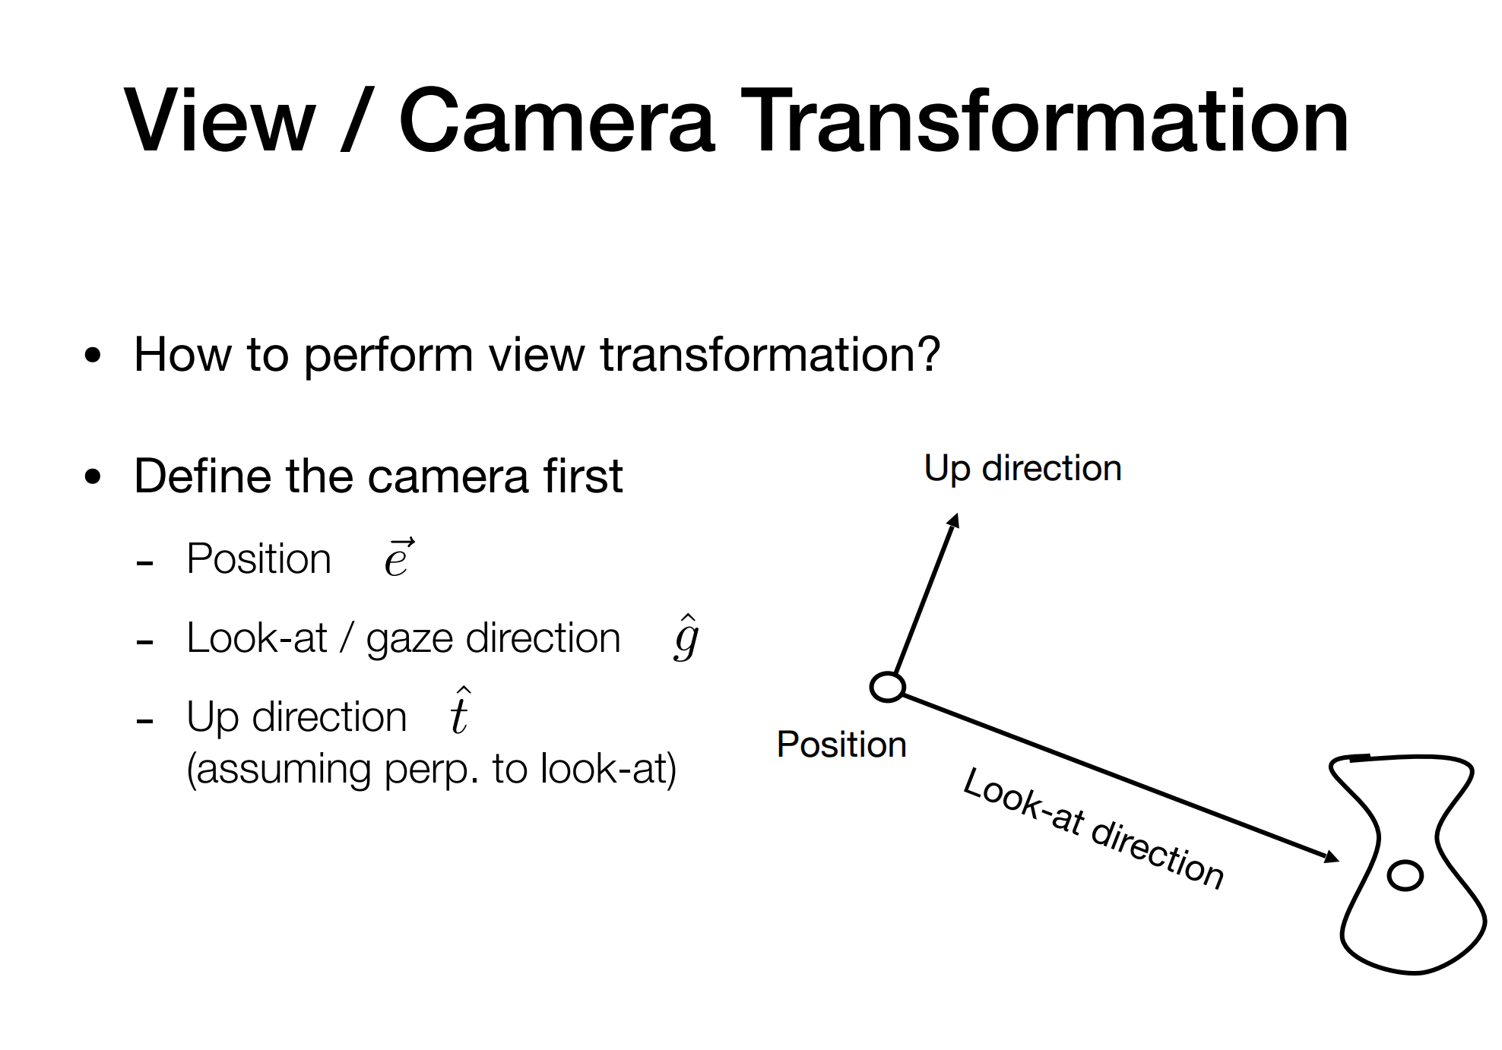

Slide 37
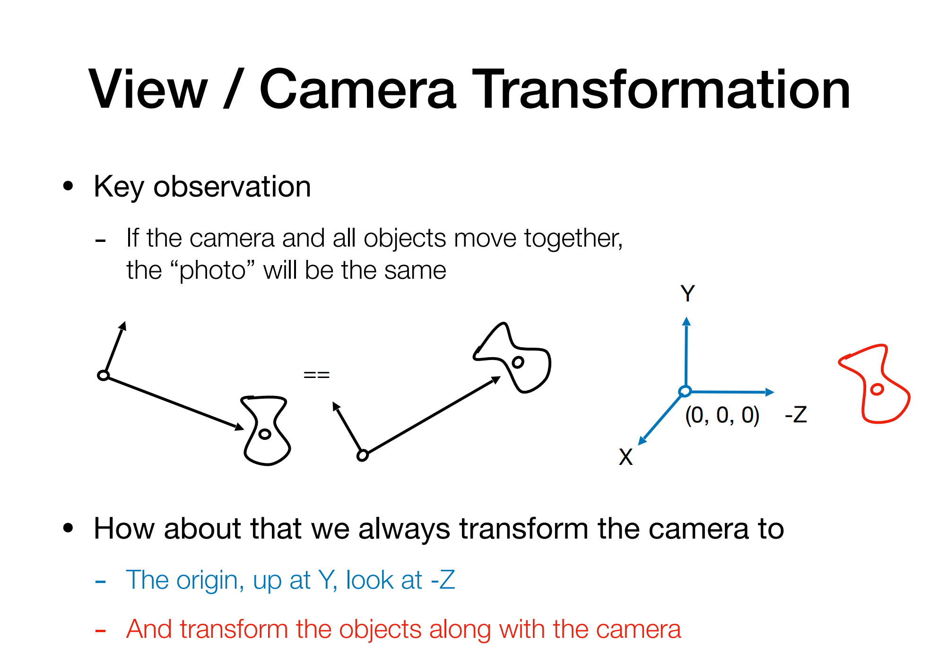

Slide 38
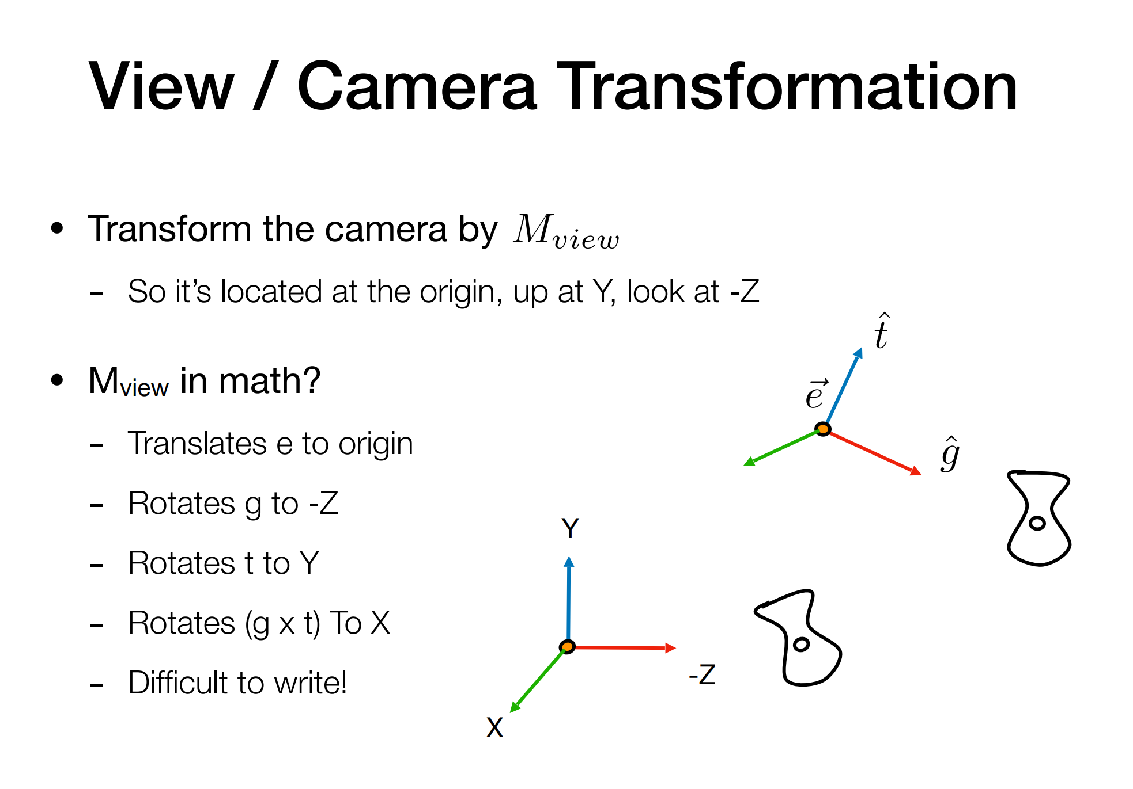

Slide 39
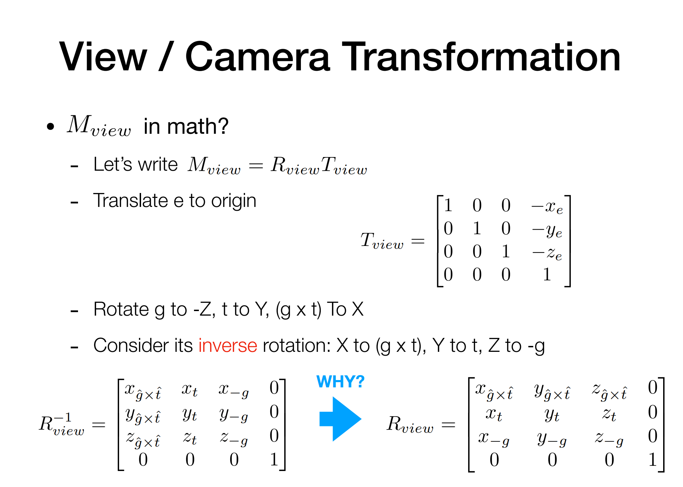

Slide 40
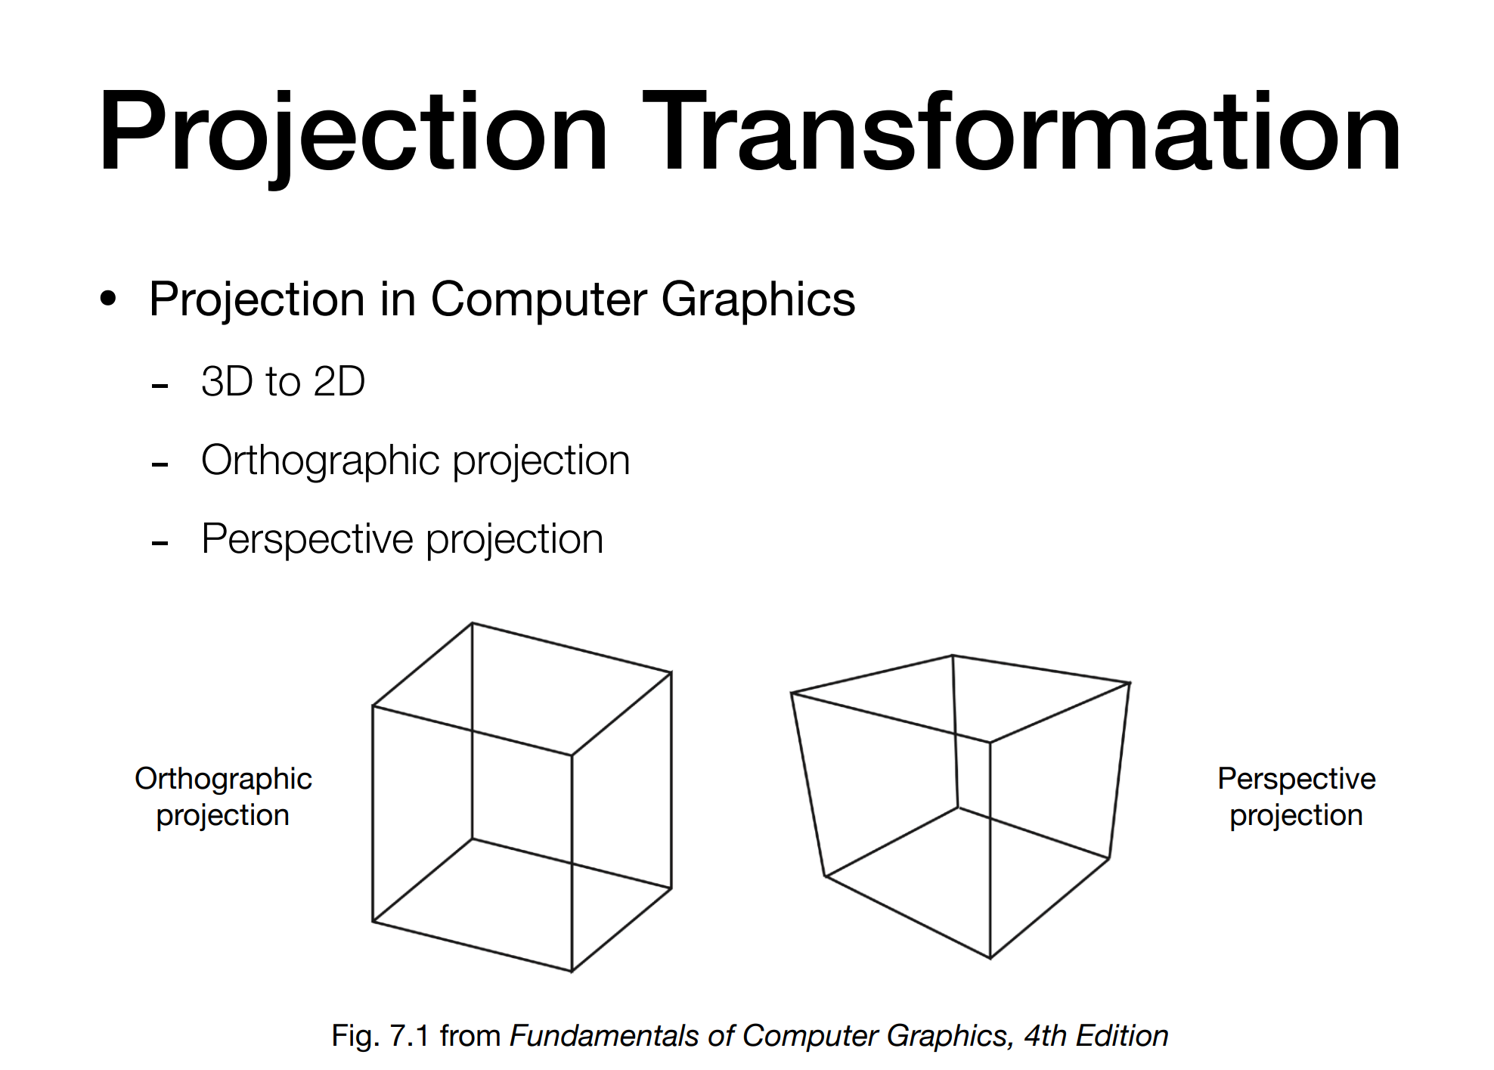

Slide 41
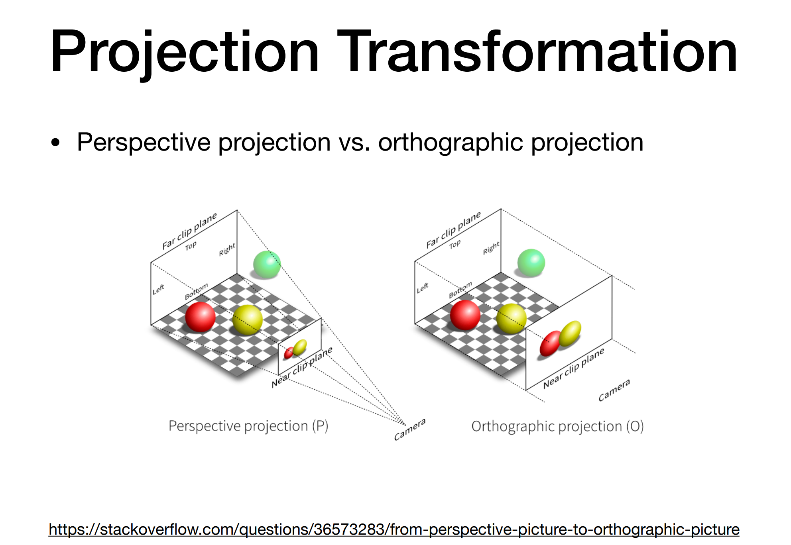

Slide 42
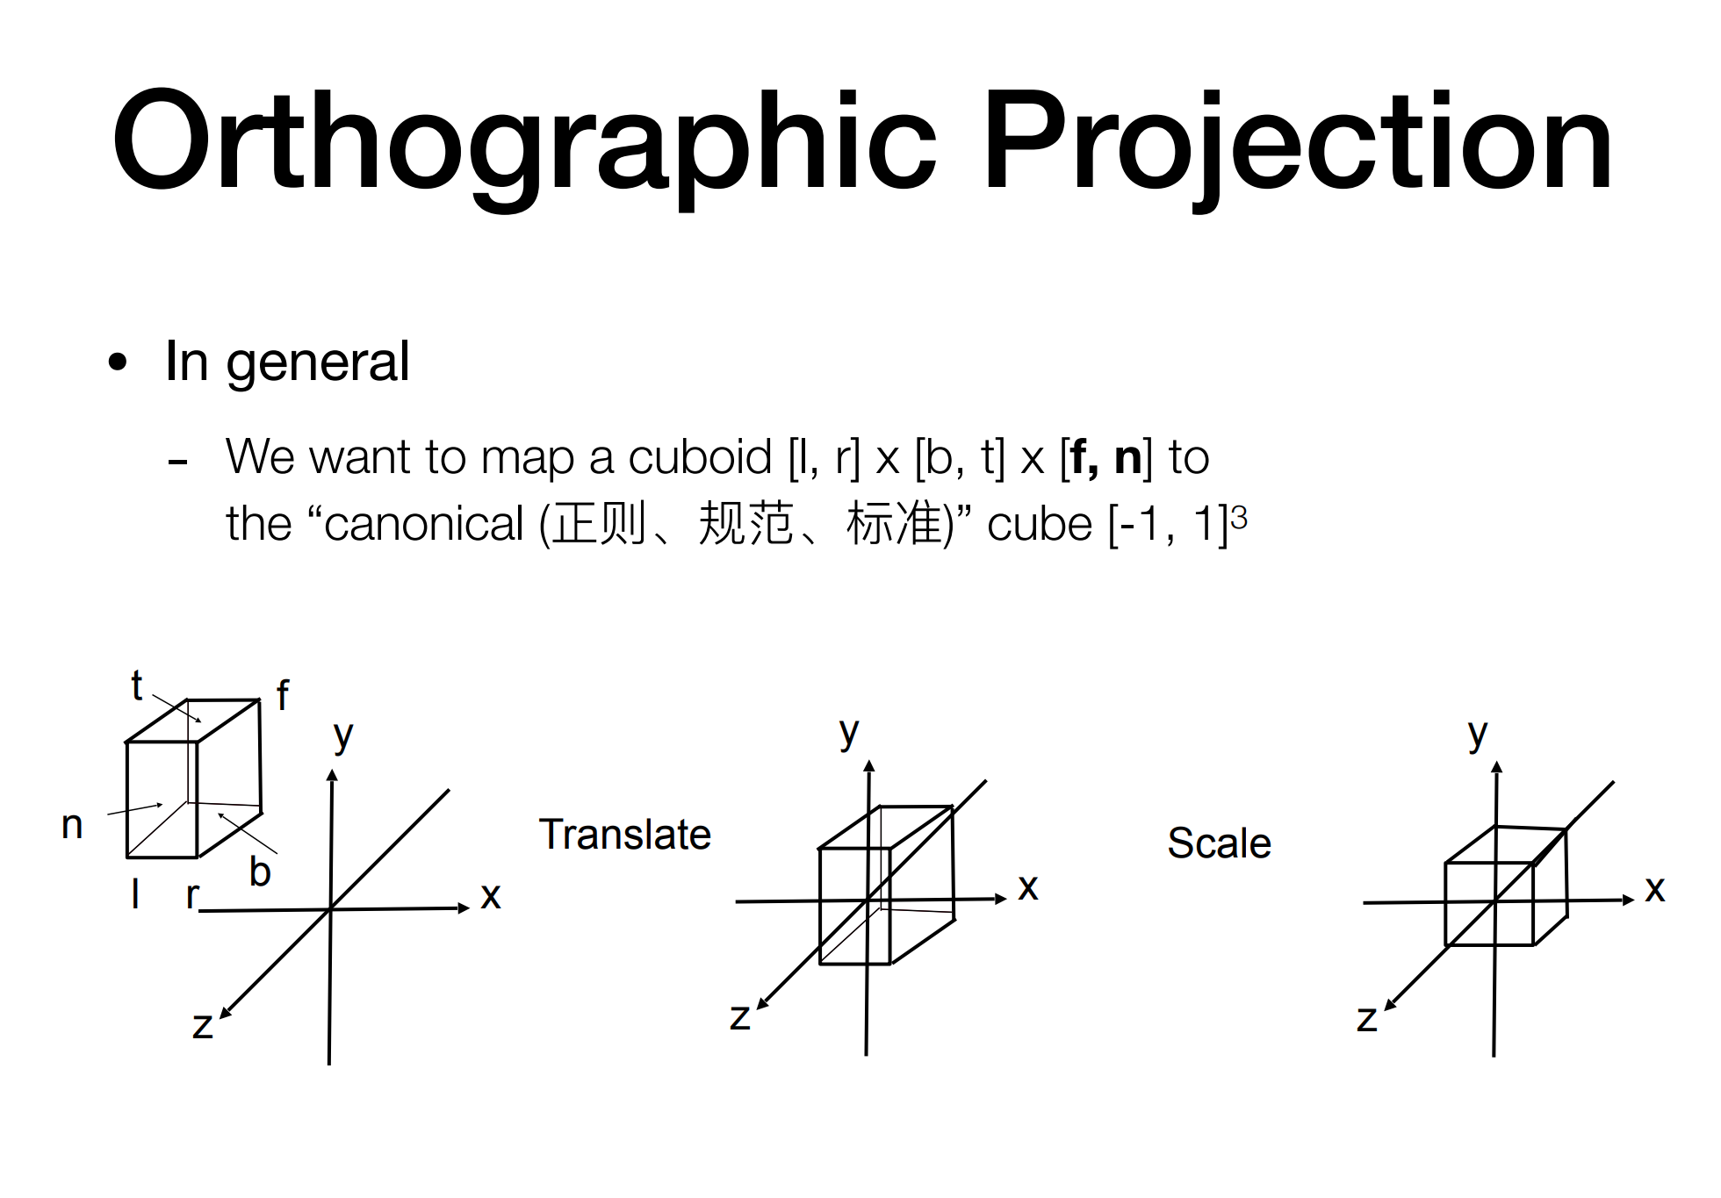

Slide 43
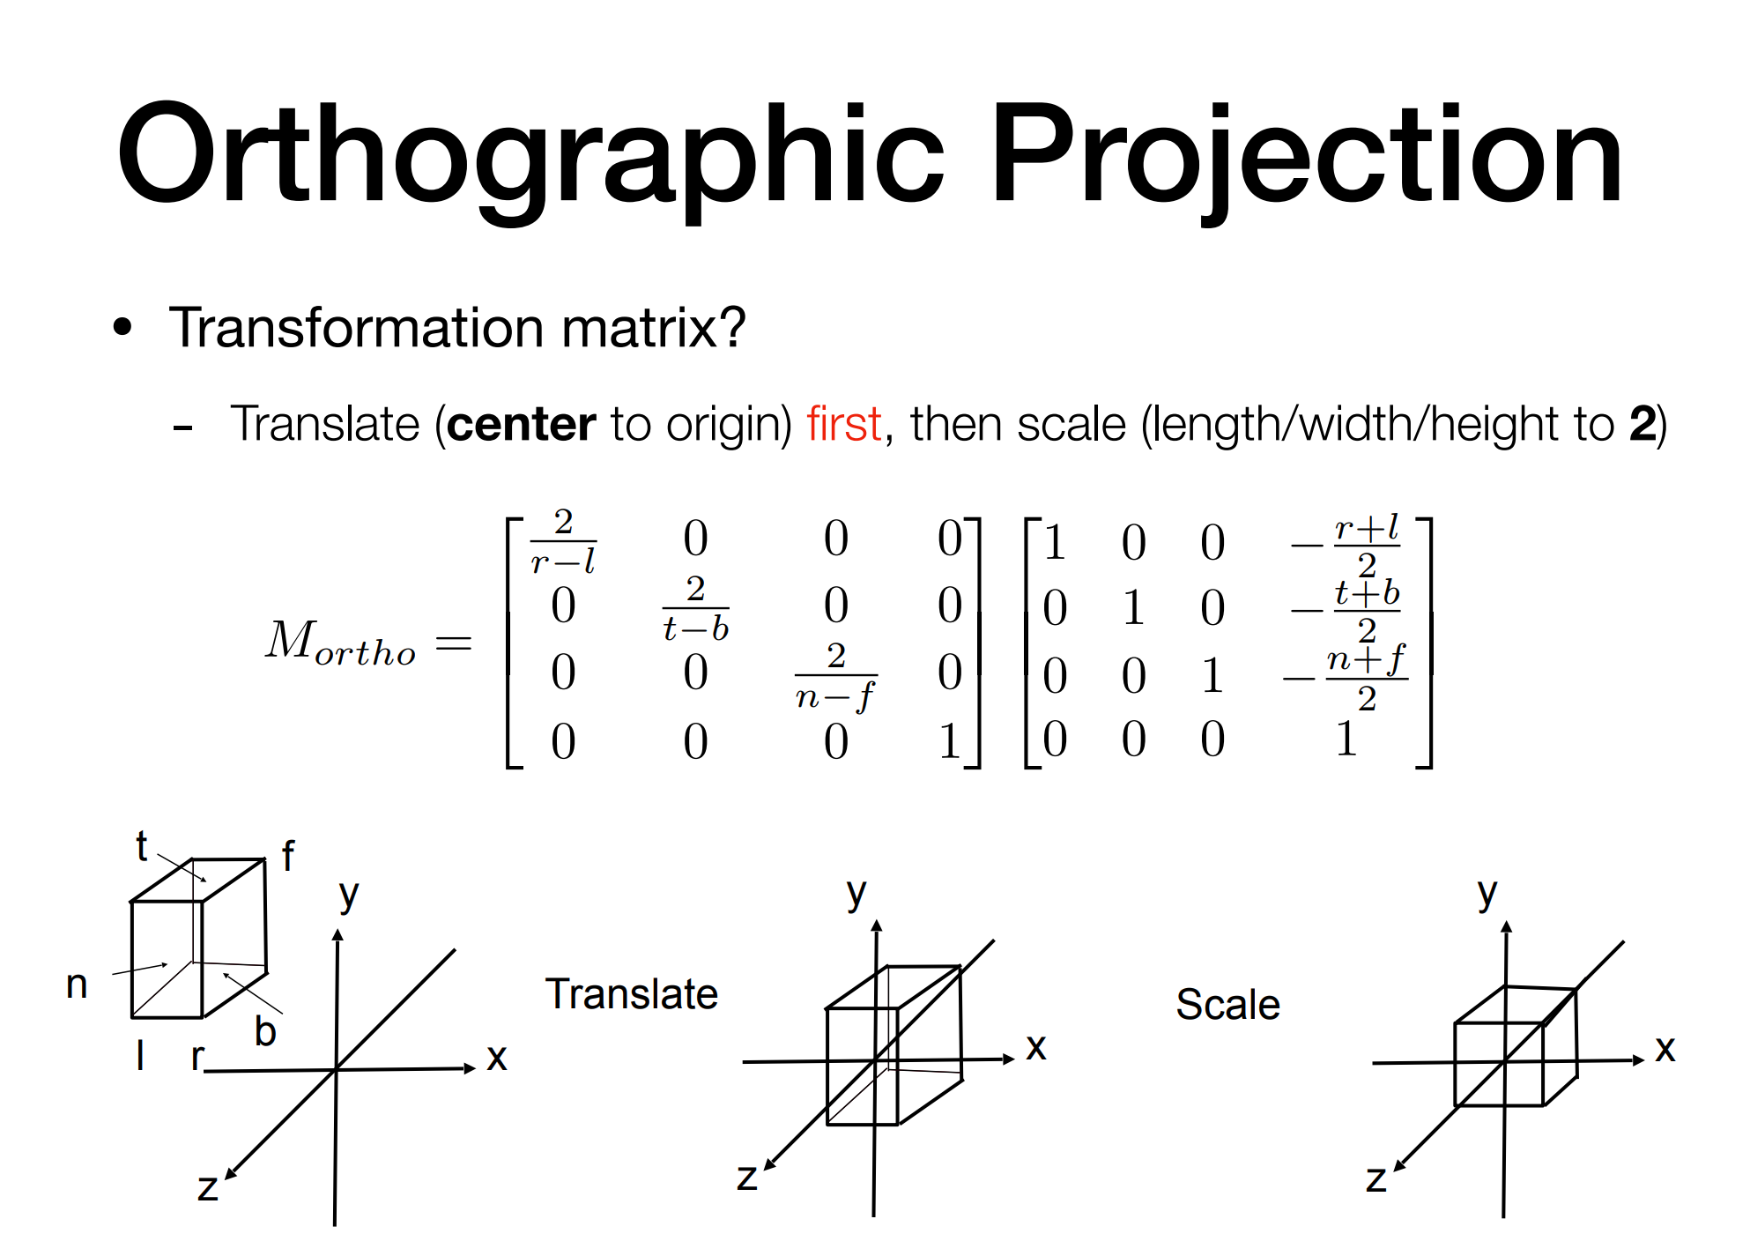

Slide 44
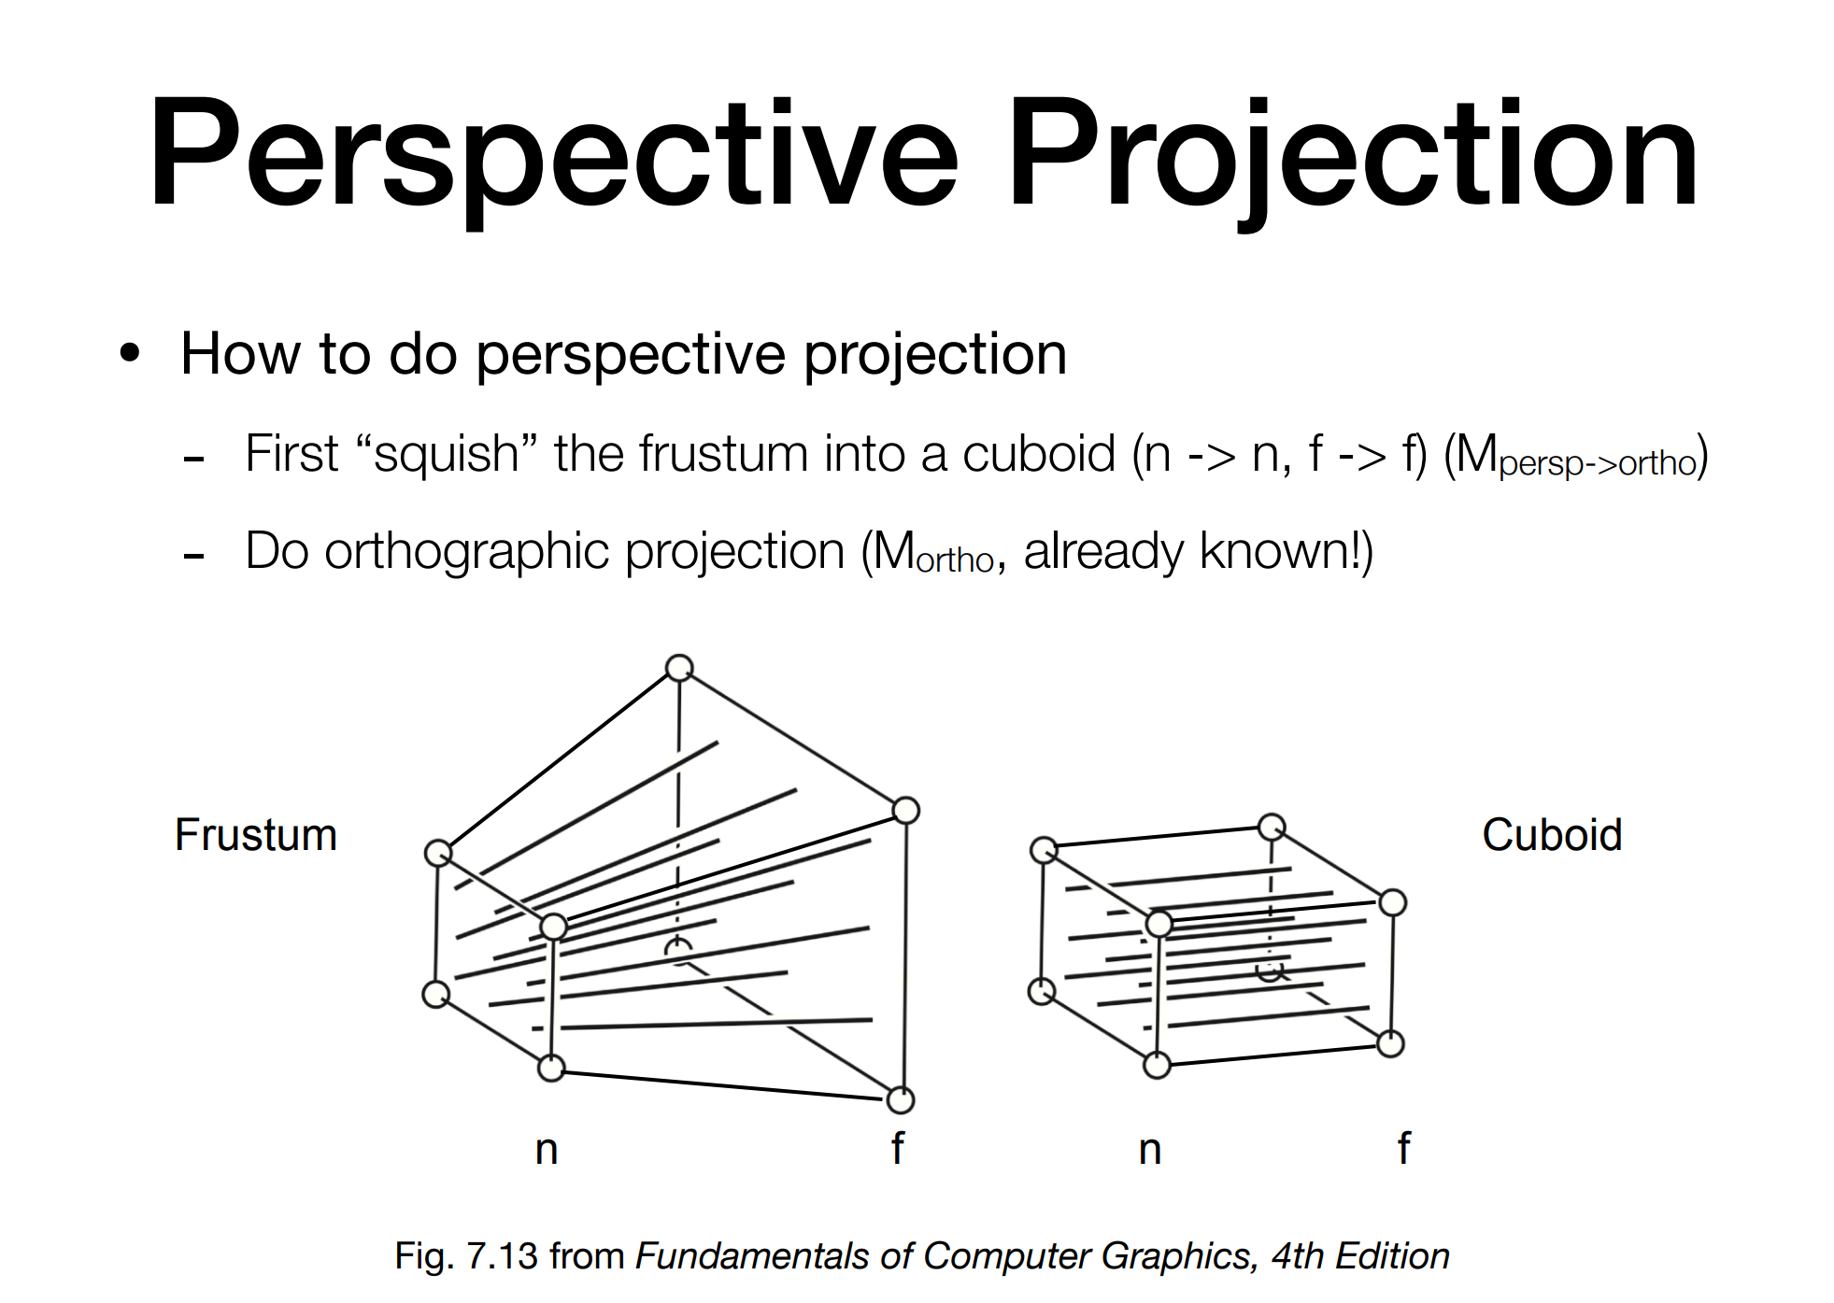

Slide 45
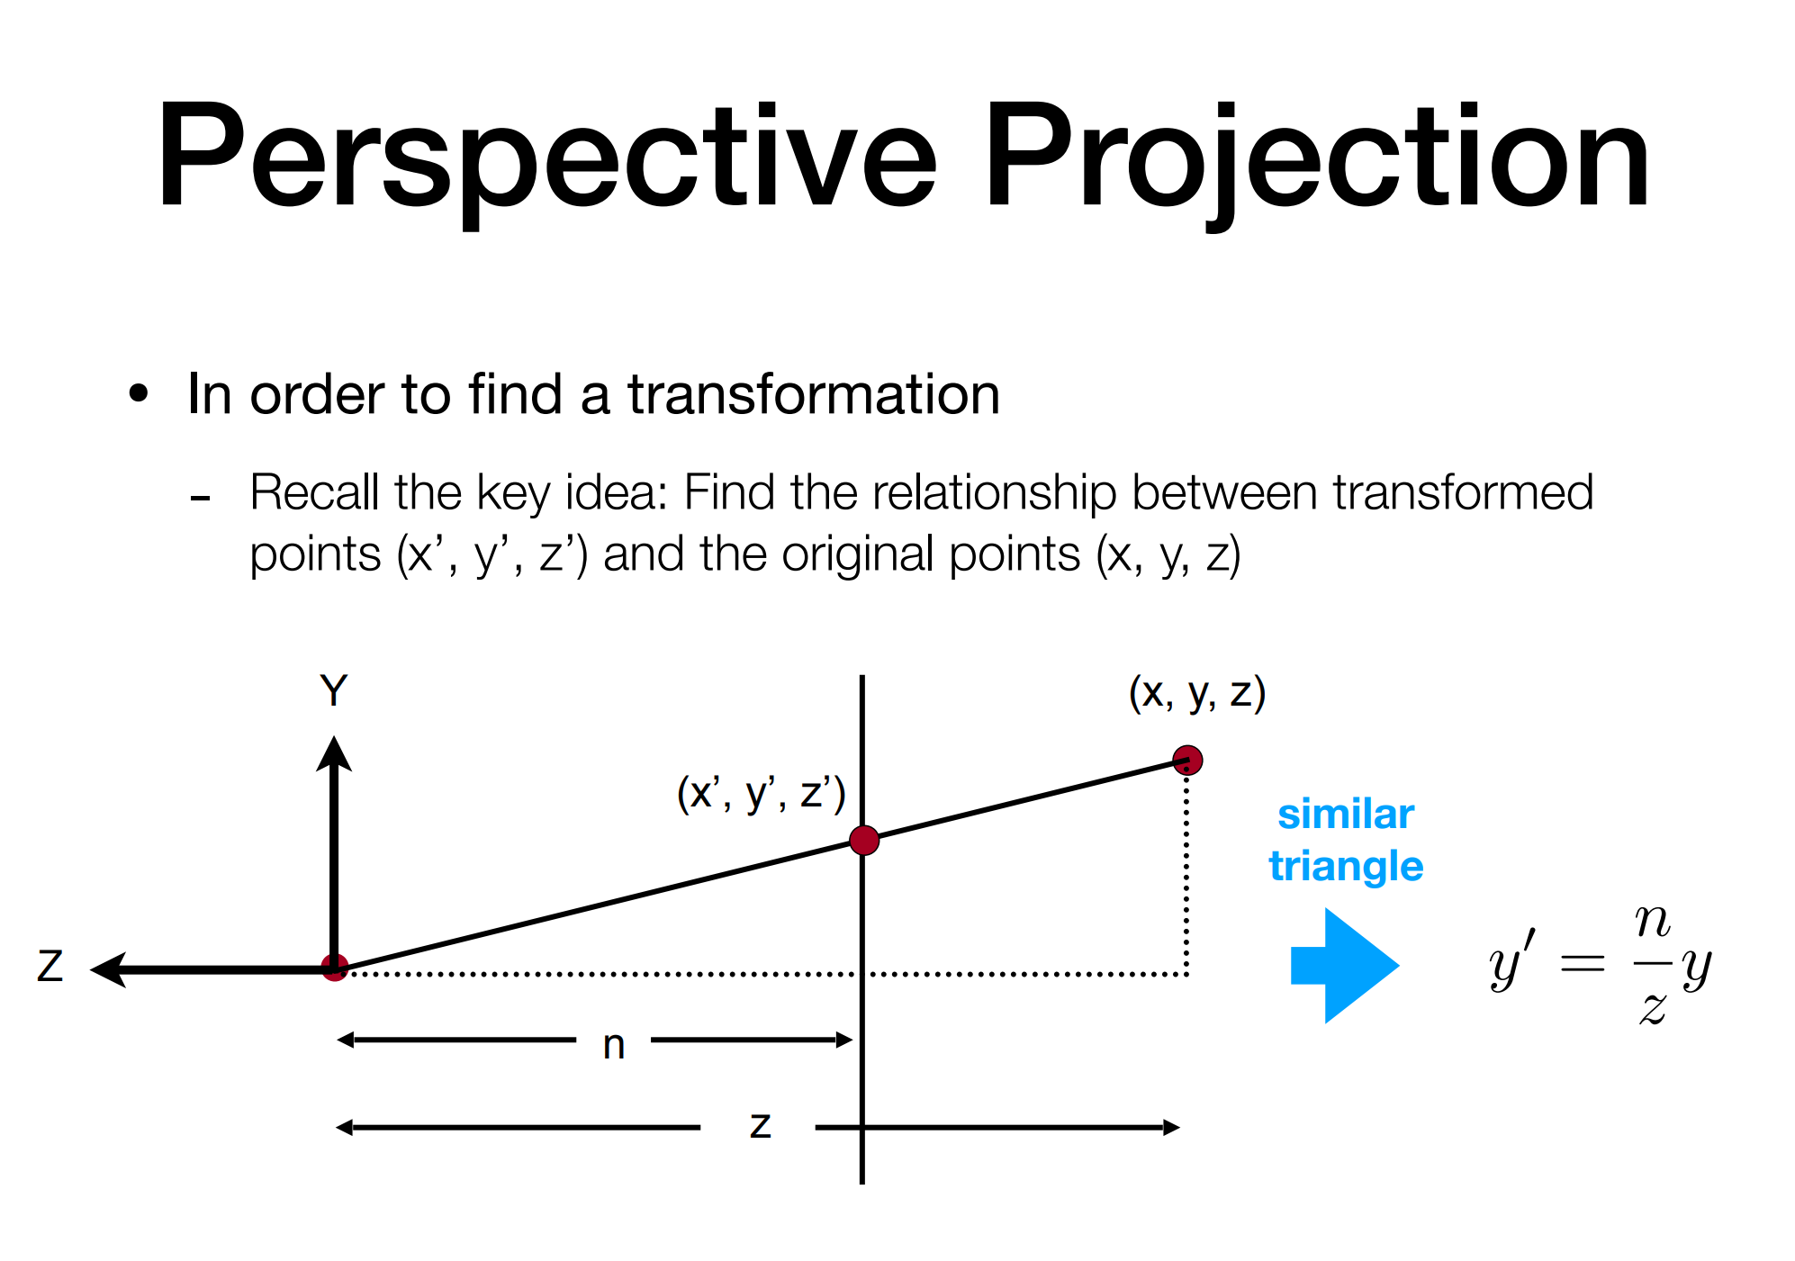

Slide 46
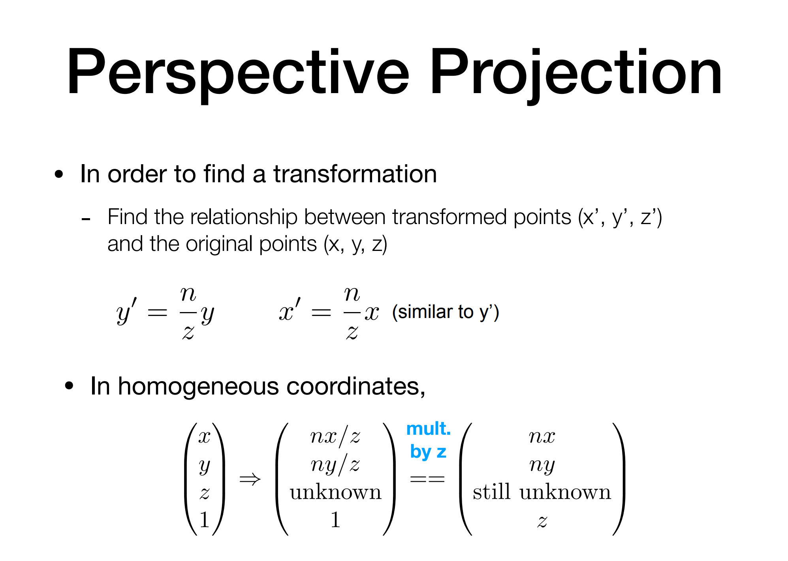

Slide 47
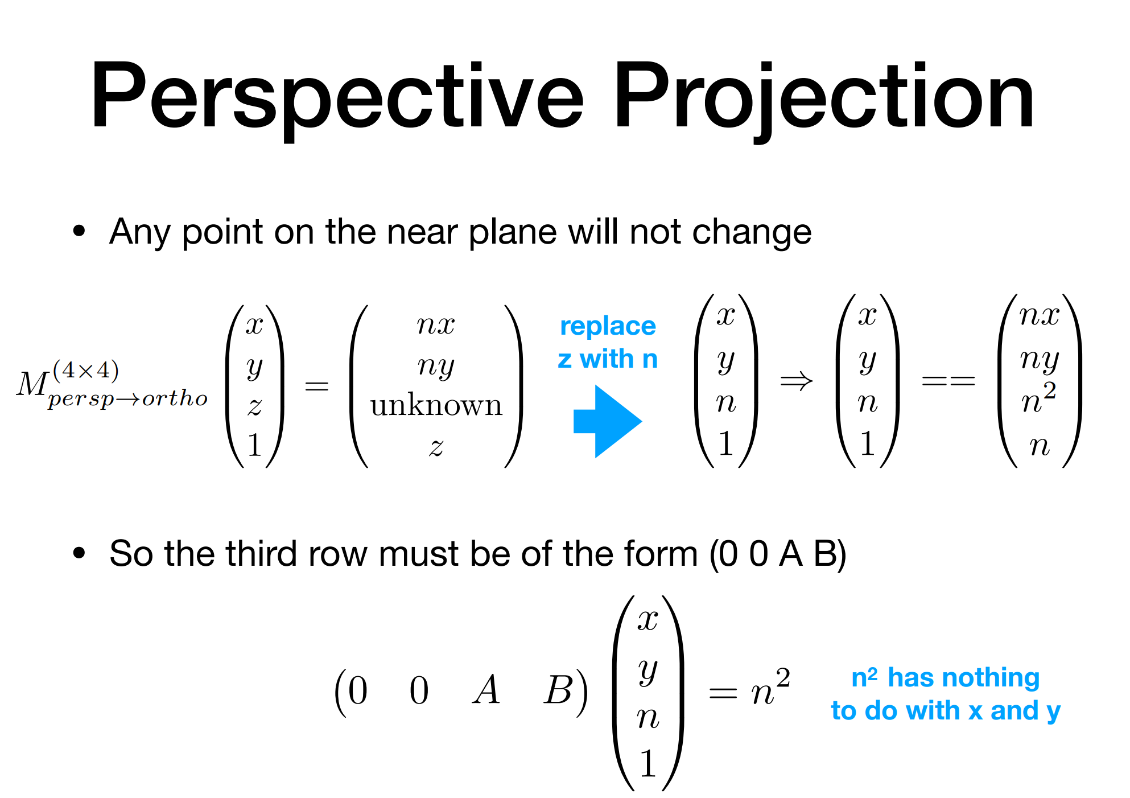

Slide 48
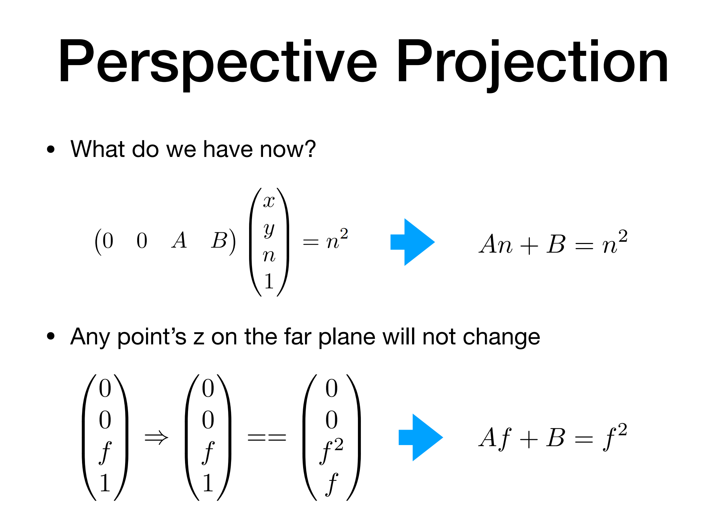

Slide 49
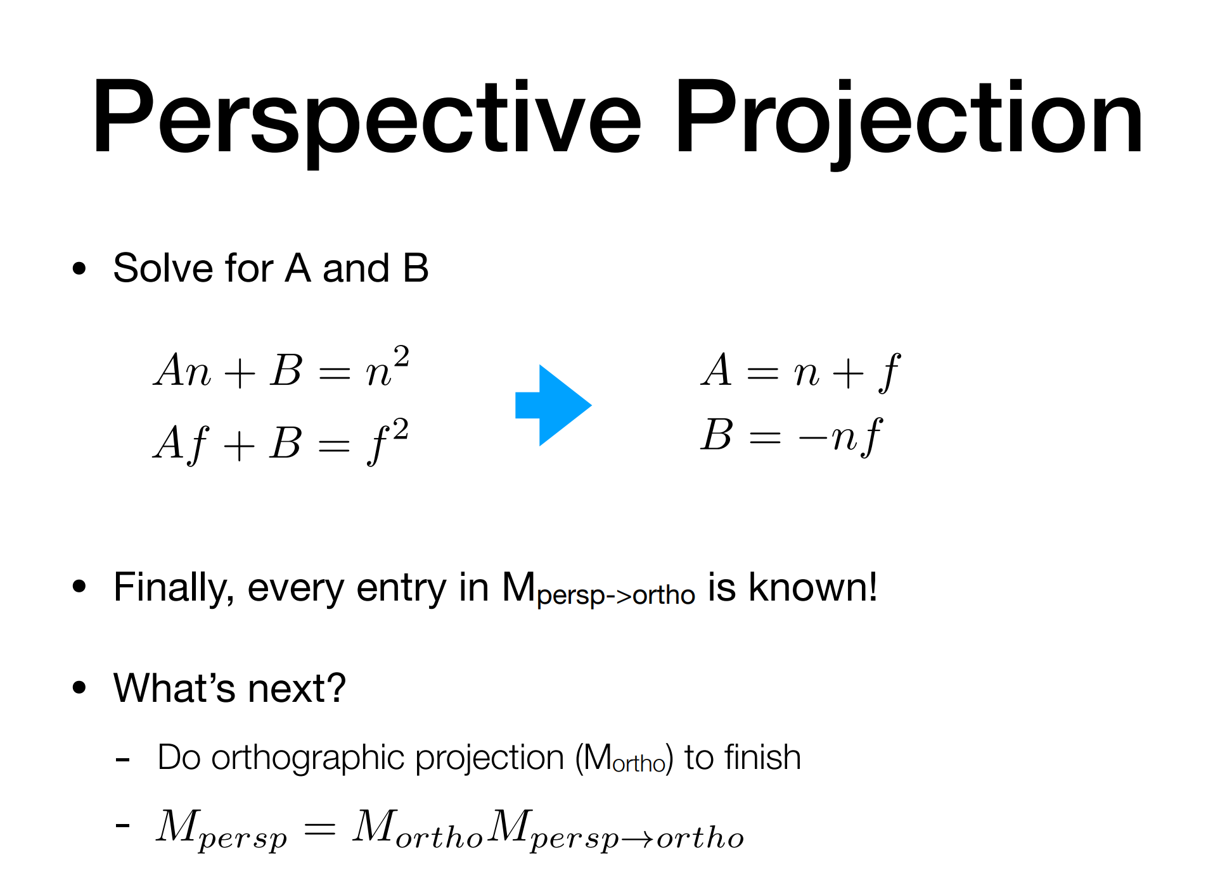

Slide 50
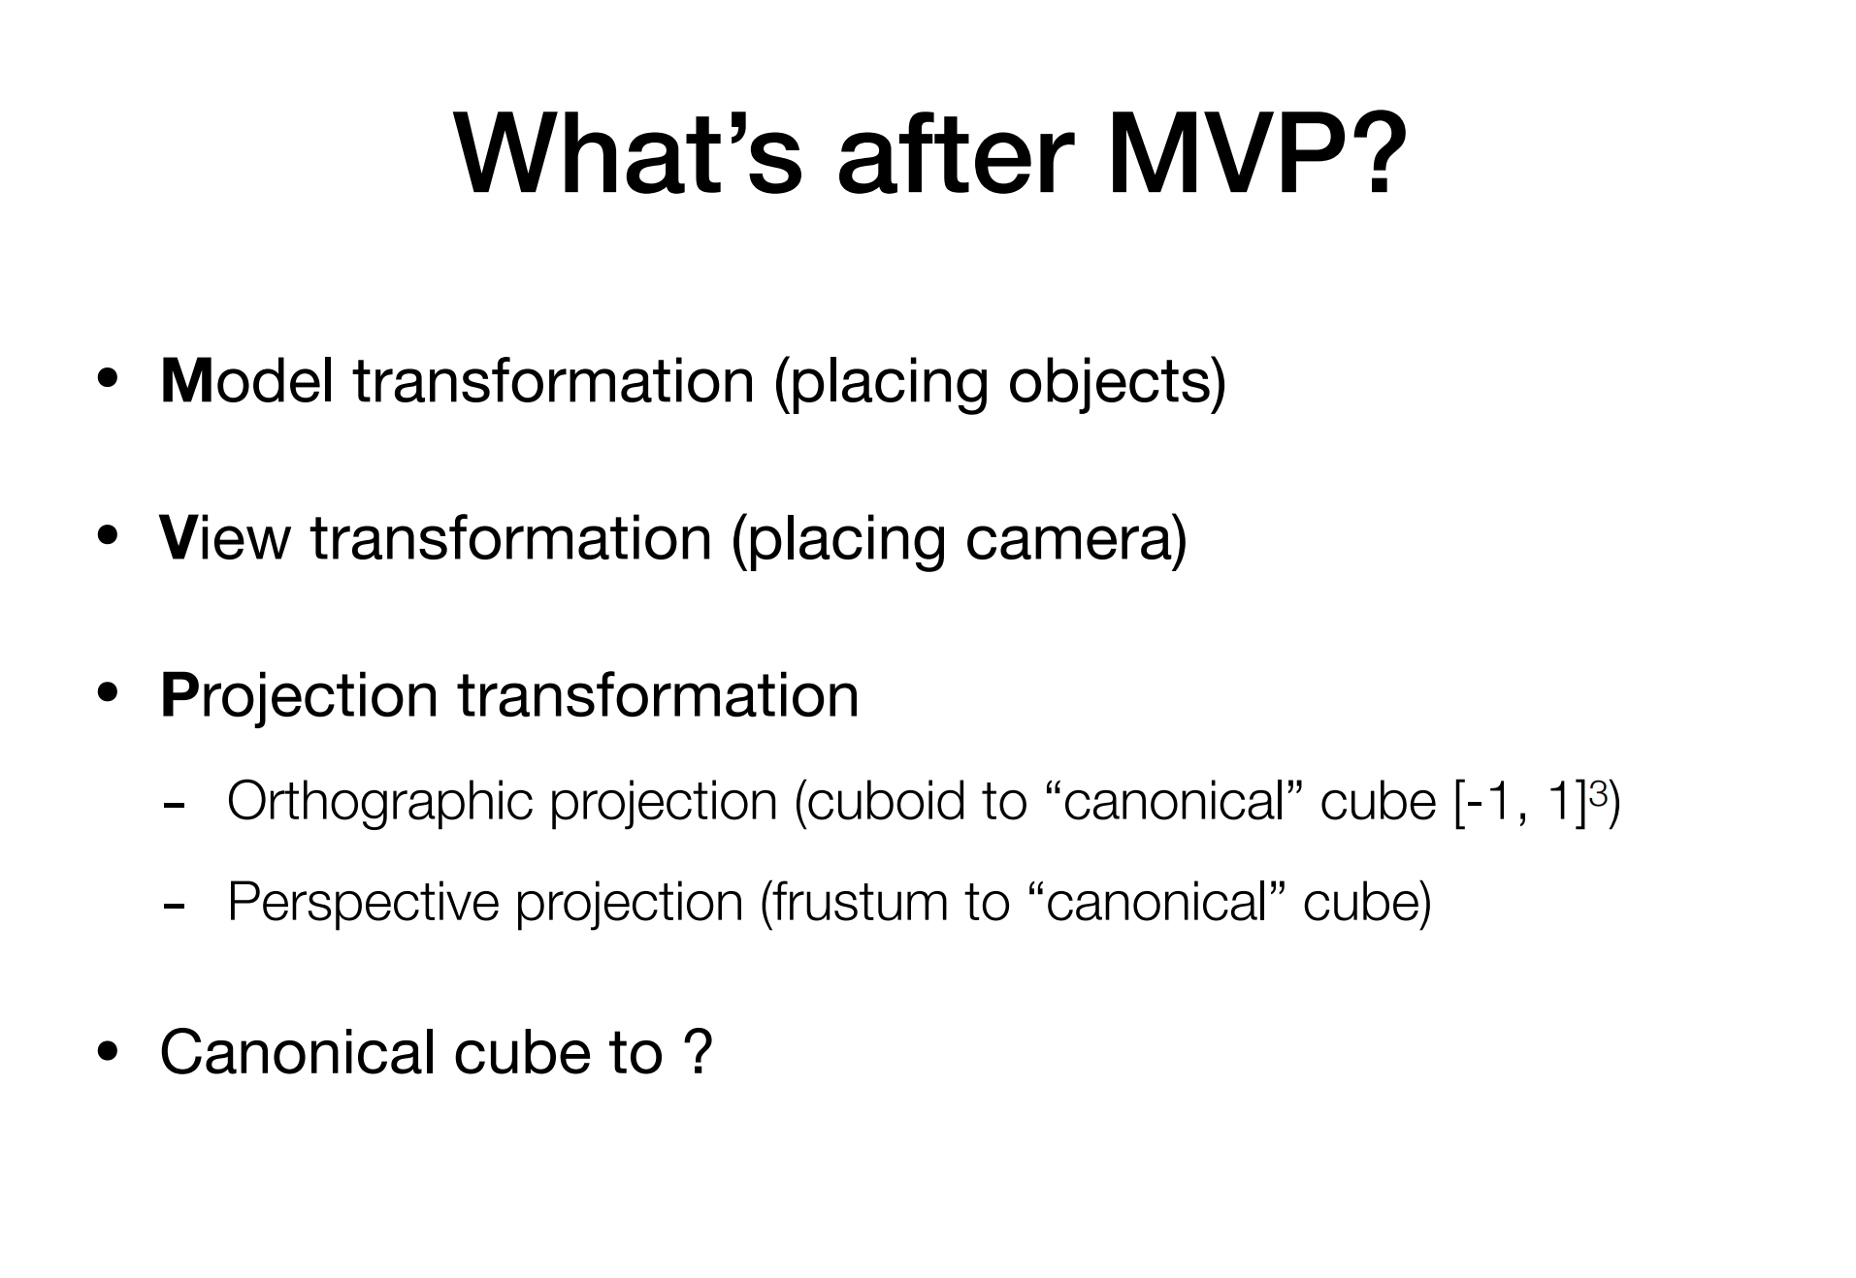

Slide 51
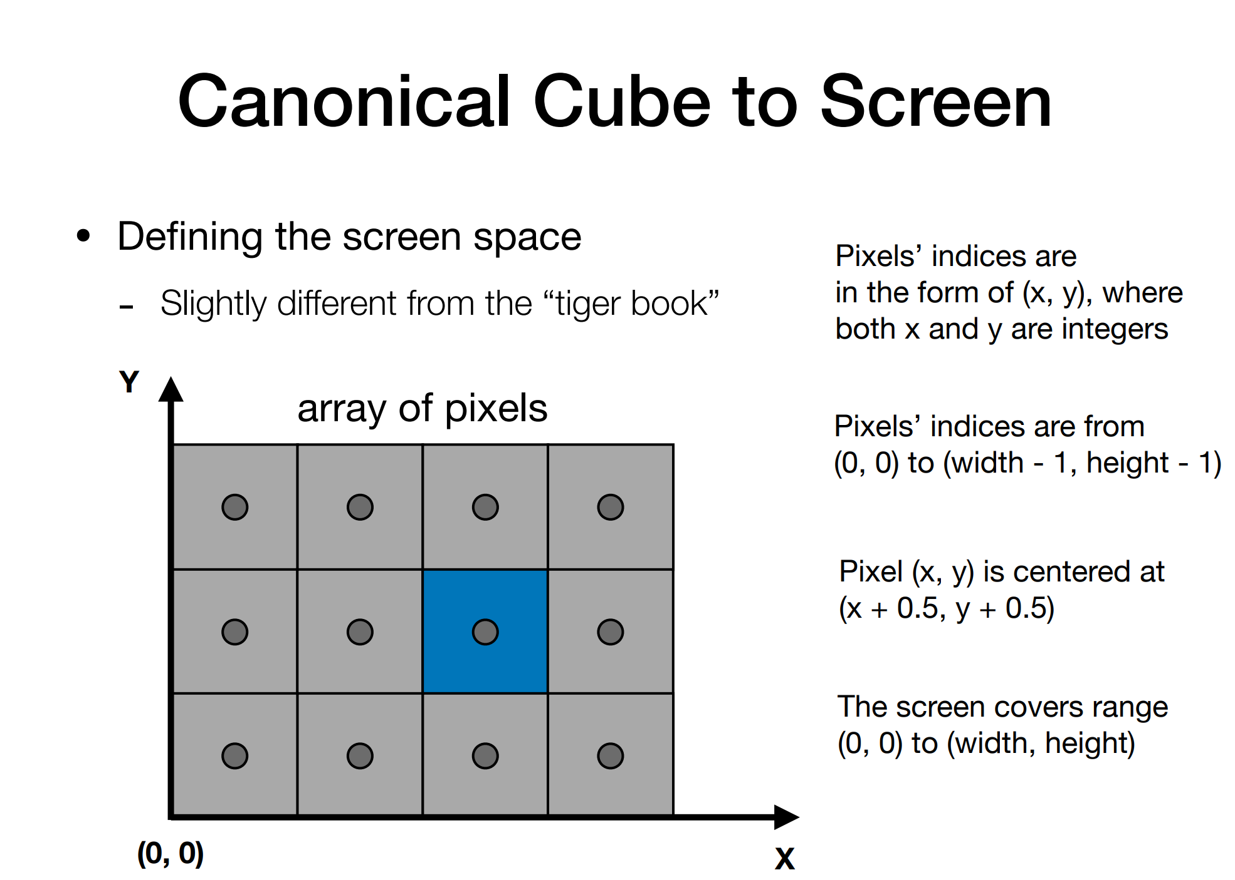

Slide 52
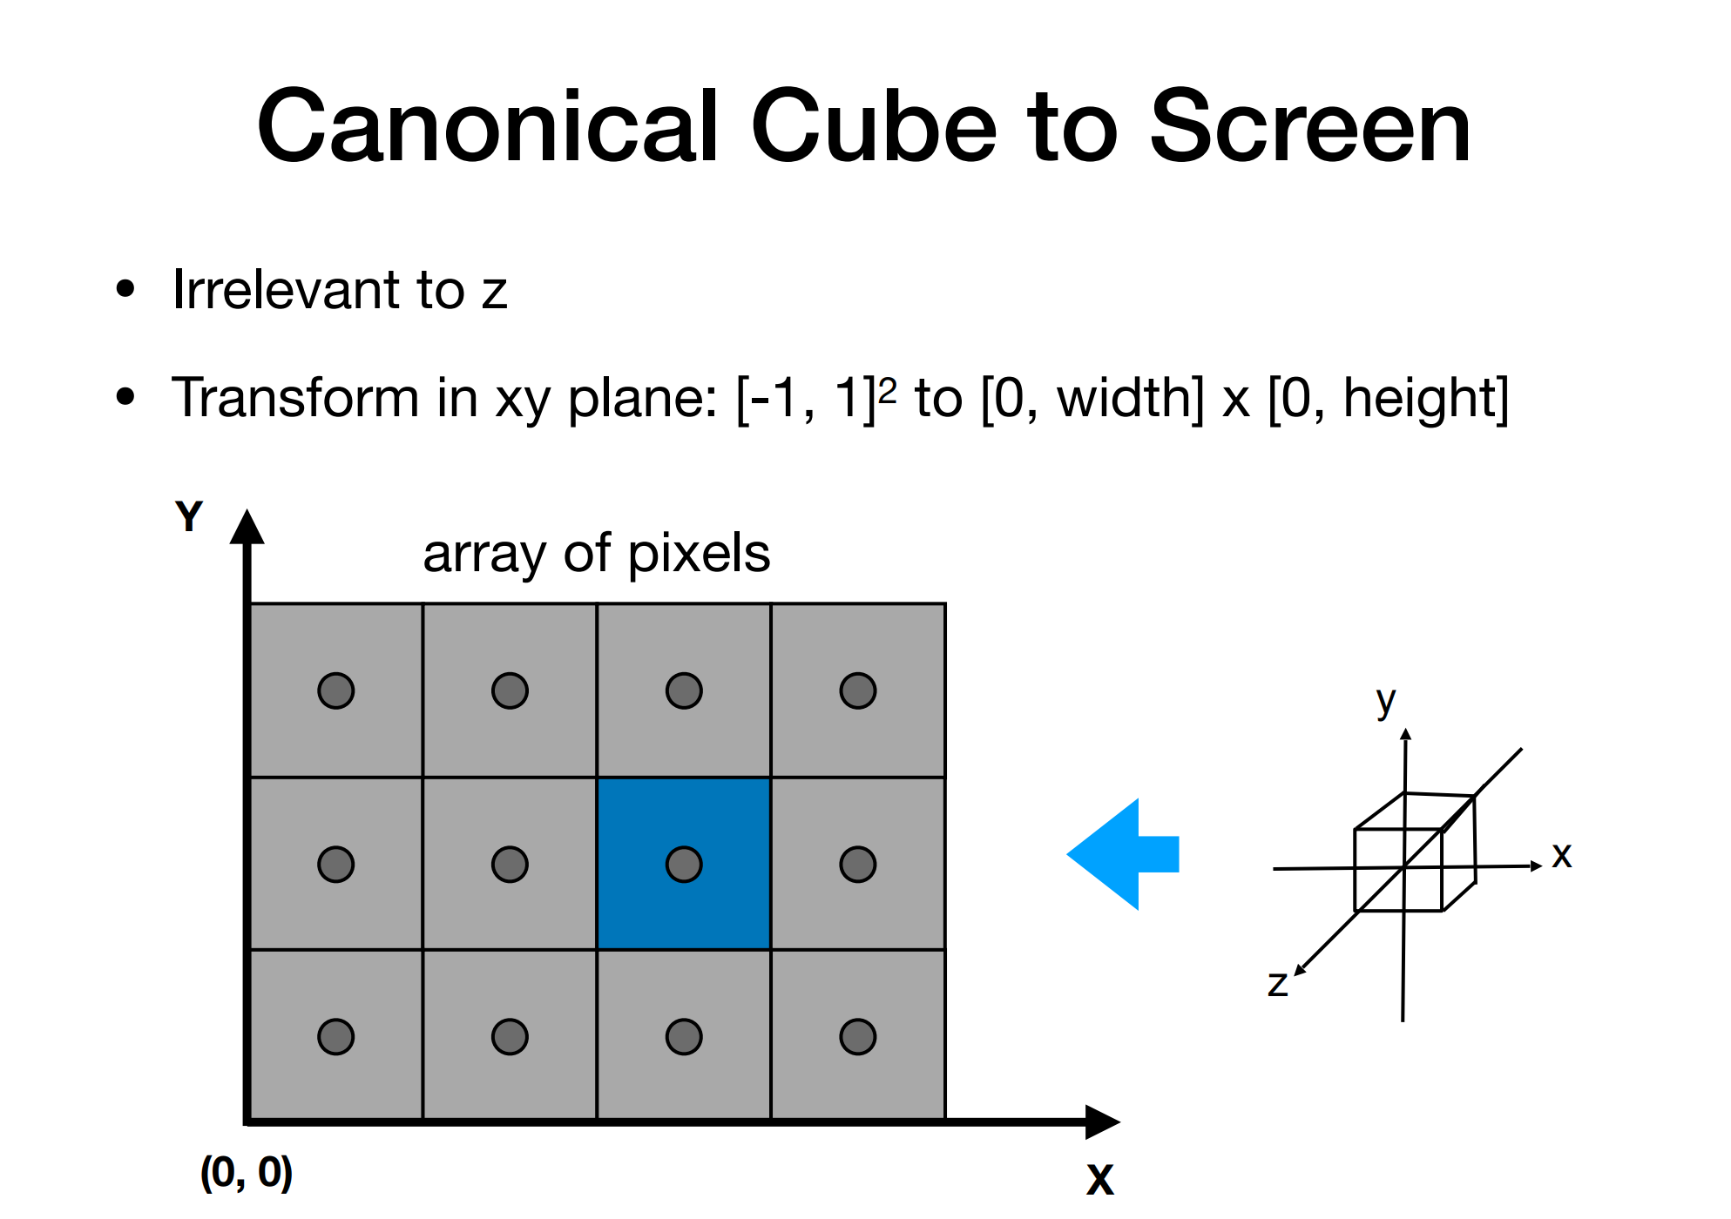

Slide 53
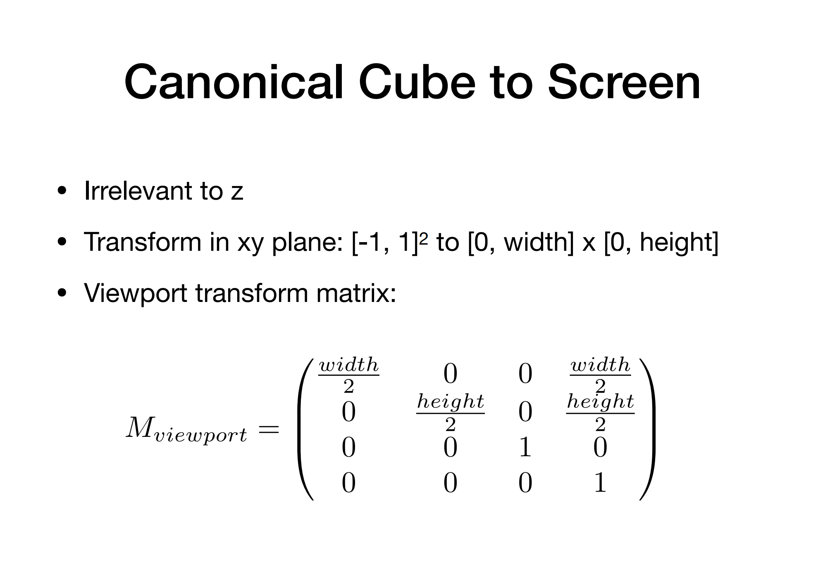

Slide 54
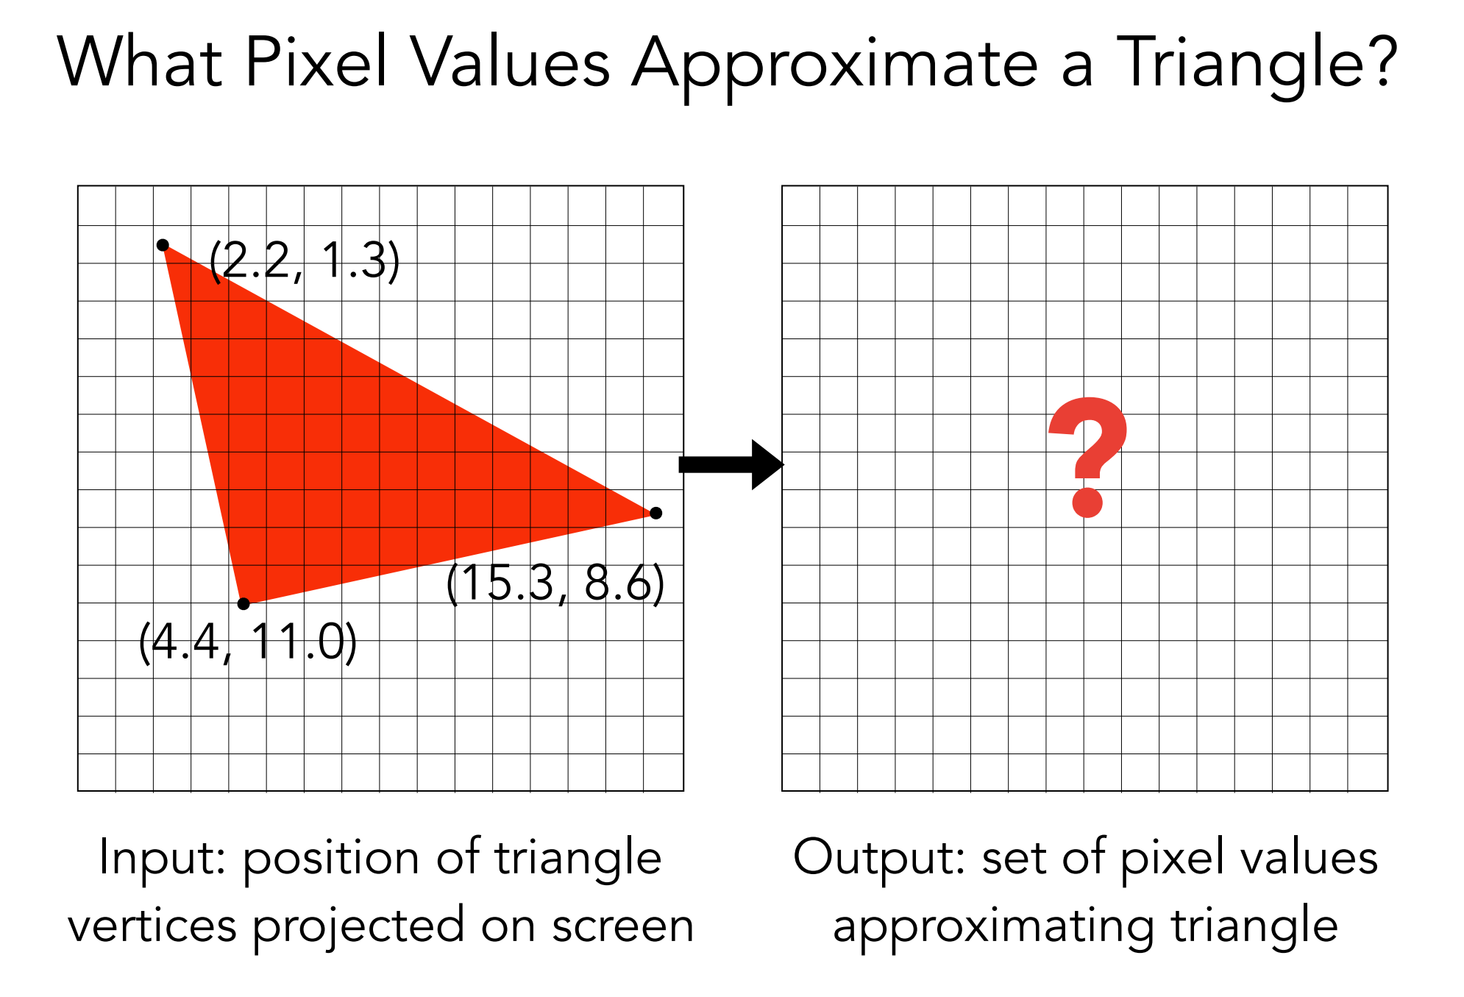

Slide 55
